Slide 1

A Deep Dive into the
New 2019 ESC/EAS Guidelines
for the management of Dyslipidaemias:
lipid modification to reduce cardiovascular risk
DEEL I: Overzicht van de belangrijkste veranderingen
DEEL II: Van theorie naar praktische oefening : 6 patiënten casussen
Task Force Members:
François Mach (ESC Chairperson) (Switzerland), Colin Baigent (ESC Chairperson) (United Kingdom), Alberico L. Catapano ( EAS Chairperson) (Italy), Konstantinos C. Koskinas (Switzerland), Manuela Casula¹ (Italy), Lina Badimon (Spain), M. John Chapman¹ (France), Guy G. De Backer (Belgium), Victoria Delgado (Netherlands), Brian A. Ference (United Kingdom), Ian M. Graham (Ireland), Alison Halliday (United Kingdom), Ulf Landmesser (Germany), Borislava Mihaylova (United Kingdom), Terje R. Pedersen (Norway), Gabriele Riccardi¹ (Italy), Dimitrios J. Richter (Greece), Marc S. Sabatine (United States of America), Marja-Riitta Taskinen¹ (Finland), Lale Tokgozoglu¹ (Turkey), Olov Wiklund¹ (Sweden).
¹Representing the European Atherosclerosis Society (EAS)
www.escardio.org/guidelines
2019 ESC/EAS Guidelines for the management of dyslipidaemias: lipid modification to reduce cardiovascular risk - Adapted from Mach F, et al. European Heart Journal 2019; 1-78
1

Slide 2
A Deep Dive into the
New 2019 ESC/EAS Guidelines
for the management of Dyslipidaemias:
lipid modification to reduce cardiovascular risk
DEEL I:
Overzicht van de belangrijkste veranderingen
www.escardio.org/guidelines
2019 ESC/EAS Guidelines for the management of dyslipidaemias: lipid modification to reduce cardiovascular risk - Adapted from Mach F, et al. European Heart Journal 2019; 1-78
1

Slide 3
DISCLOSURES
Disclosures

Slide 4
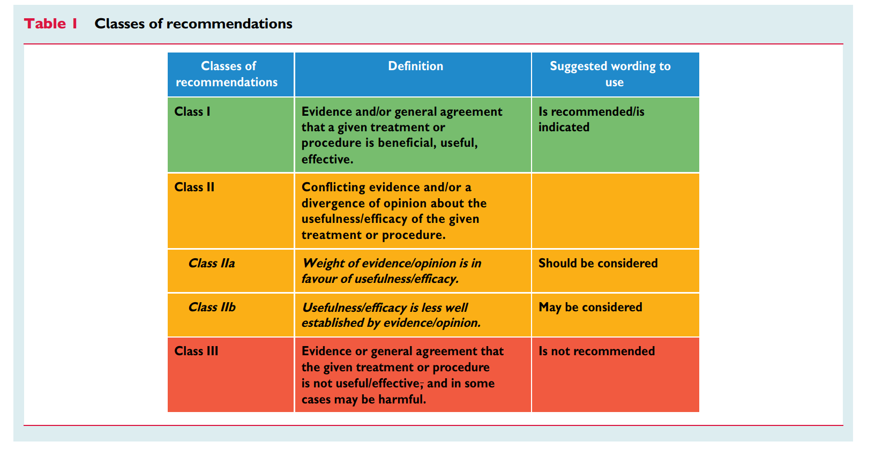
CLASSES OF RECOMMENDATIONS
Mach F, et al. Eur Heart J. 2019;0:1–78

Slide 5
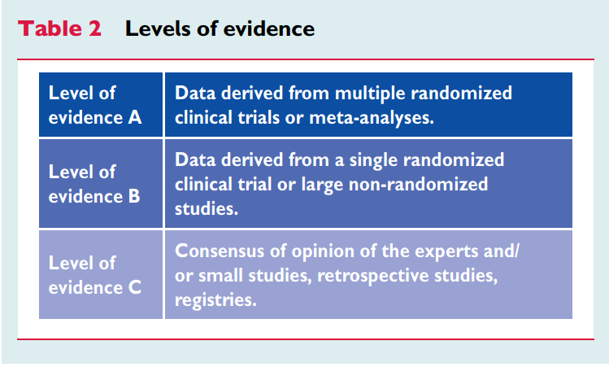
LEVELS OF EVIDENCE
Mach F, et al. Eur Heart J. 2019;0:1–78

Slide 6
DEEP DIVE INTO THE GUIDELINES
Risk categories
Risk assessment
Fundamental Principles for LDL-Lowering Therapy
Treatment Goals
Intervention strategies
Recommendations & treatment Algorithm for pharmacological LDL-C lowering
Algoritm for the treatment of muscular symptoms during statin treatment

Slide 7
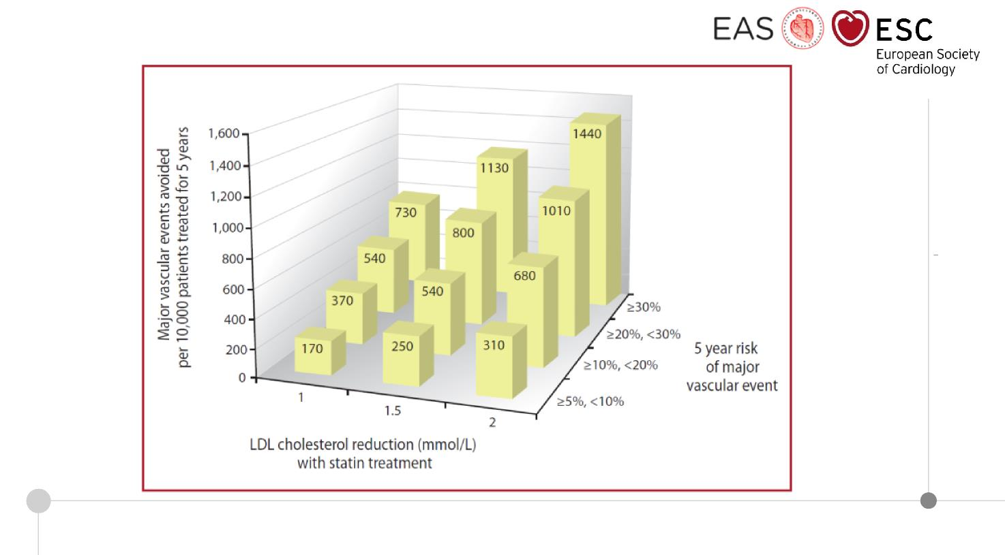
Absolute reductions in major vascular events with statin therapy
Mach F, et al. Eur Heart J. 2019; 0:1-78

Slide 8
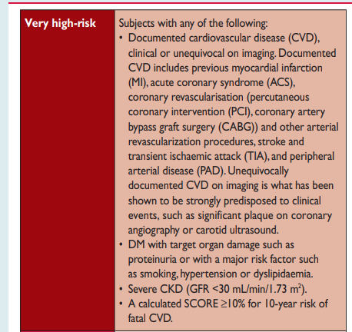
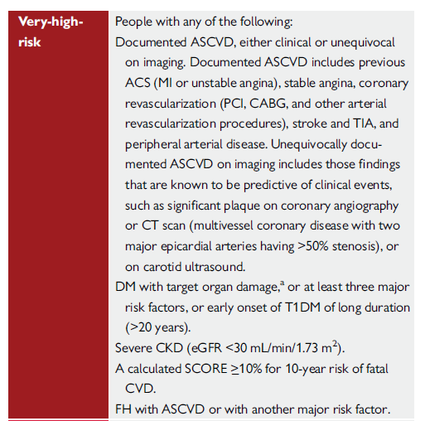
CARDIOVASCULAR RISK CATEGORIES
2016
2019
ASCVD definition more precise
DM definition more precise
  T1DM of long duration added
FH with ASCVD or another risk factor added
Catapano A, et al. Eur Heart J. 2016; 37, 2999-3058 - Mach F, et al. Eur Heart J. 2019; 0:1-78
Notes:
Patients with FH and ASCVD, or another major risk factor, are classified as very-high-risk, and those without known ASCVD and without other risk factors as high-risk. Recommended treatment goals are defined accordingly.

Slide 9
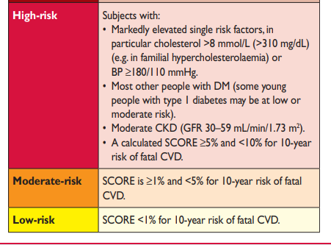
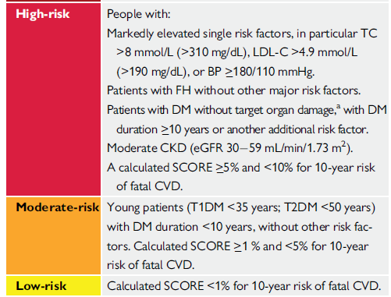
CARDIOVASCULAR RISK CATEGORIES
2016
2019
Mach F, et al. Eur Heart J. 2019; 0:1-78
Catapano A, et al. Eur Heart J. 2016; 37, 2999-3058

Slide 10
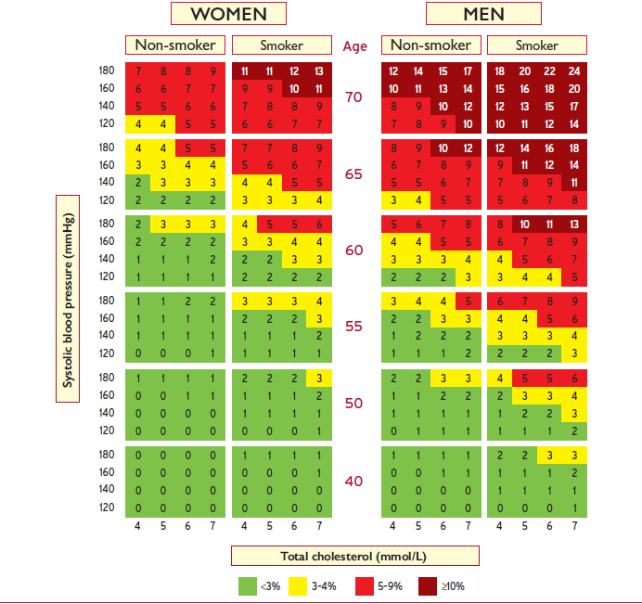
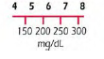
RISK ASSESSMENT : 10 year risk of fatal CVD
Low risk regions of Europe → age interactions included
The risk of this 40 year old male smoker with risk factors is the same (3-4%) as that of a 65 year-old man with ideal risk factor levels – therefore his risk age is 65 years
Mach F, et al. Eur Heart J. 2019; 0:1-78

Slide 11
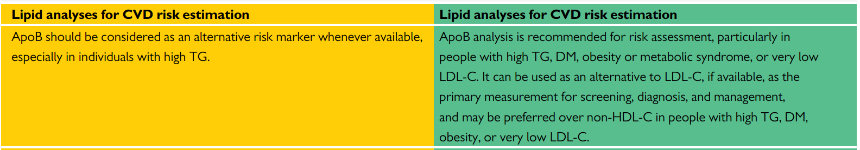
RISK ASSESSMENT - ApoB ANALYSIS
2016
2019
For CVD risk estimation
ApoB analysis NOW RECOMMENDED
(patients with high TG; DM; obesity or metabolic syndrome or very low LDL-C)
Mach F, et al. Eur Heart J. 2019; 0:1-78
Catapano A, et al. Eur Heart J. 2016; 37, 2999-3058

Slide 12
RISK ASSESSMENT - Imaging and Lp(a)
NEW
Cardiovascular imaging for assessment of ASCVD risk Assessment of arterial (carotid and/or femoral) plaque burden on arterial ultrasonography should be considered as a risk modifier in individuals at low or moderate risk.
Cardiovascular imaging for assessment of ASCVD risk CAC score assessment with CT should be considered as a risk modifier in the CV risk assessment of asymptomatic individuals at low or moderate risk.
Lipid analyses for CVD risk estimation Lp(a) measurement should be considered at least once in each adult person’s lifetime to identify those with very high inherited Lp(a) levels >180 mg/dL (>430 nmol/L) who may have a lifetime risk of ASCVD equivalent to the risk associated with heterozygous familial hypercholesterolaemia.
Mach F, et al. Eur Heart J. 2019; 0:1-78
Notes:
New recommendations

Slide 13
FUNDAMENTAL PRINCIPLES FOR LDL-LOWERING THERAPY
Trials of LDL-lowering indicate RELATIVE RISK reduction is proportional to the ABSOLUTE REDUCTION in LDL-C
Lower is better: lowering LDL-C with statins, ezetimibe, or PCSK9-inhibitors safe and effective to < 55 mg/dL (1.4 mmol/L )
Intensity of LDL-lowering therapy should be based on:
  (A) risk, irrespective of cause(s) of the risk (e.g., primary or secondary prevention, diabetes, or chronic kidney disease)
  AND
  (B) baseline LDL cholesterol (which determines how much reduction in risk can be achieved)
Mach F, et al. Eur Heart J. 2019; 0:1-78
Notes:
Absolute LDL-C reduction dictates RRR and defines ARR

Slide 14
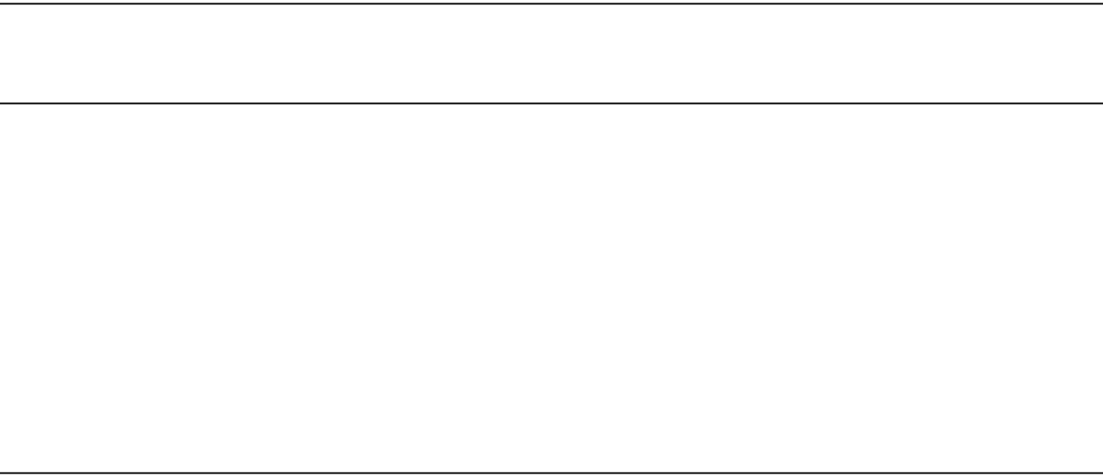
EVIDENCE FOR EFFICACY OF LDL-LOWERING THERAPIES
DOWN TO BELOW 1.4 mmol/L - 55 mg/dL
Source of evidence | Mean reduction in LDL cholesterol; mmol/L [mg/dL]
CTT meta-analysis¹ (high-intensity vs standard statin; subgroup <2.0 mmol/L) | 1.71 | [66] vs 1.32 | [50]
IMPROVE-IT² (eze plus statin vs statin) | 1.55 | [70] vs 1.40 | [54]
FOURIER³ (evolocumab plus high-dose statin ± eze vs high-dose statin ± eze) | 2.37 | [92] vs 0.78 | [30]
ODYSSEY OUTCOMES⁴ (alirocumab plus high-dose statin ± eze vs high-dose statin ± eze) | 2.37 | [92] vs 1.37 | [53]
Outcome RR (95% CI)
MI, CHD death,
stroke, coronary
revasc.
0.71 (0.56-0.91) [per mmol/L]
CV death, MI,
stroke, UA,
coronary revasc
0.94 (0.89-0.99)
CV death, MI,
stroke, UA,
coronary revasc
0.85 (0.79-0.92)
MI, CHD death, stroke, UA
0.85 (0.78-0.93)
^{1.}Lancet 2010; 376: 1670-81; ^{2.} NEJM 2015; 372: 2387-97; ^{3.} NEJM 2017; 376: 1713-22; ^{4.} NEJM 2018; 379: 2097-107
Mach F, et al. Eur Heart J. 2019; 0:1-78
Notes:
Back up documentation

Slide 15
RECOMMENDED TREATMENT GOALS FOR LDL-LOWERING THERAPY:
MAIN CHANGES FROM 2016 to 2019
Risk category
LDL goals (starting with untreated LDL-C)
2016 2019
Very-high-risk
High-risk
Moderate-risk Low-risk
1
B
<1.8 mmol/L (70 mg/dL)
or >50% if LDL-C 1.8-3.5
(70 - 135 mg/dL)
<2.6 mmol/L (100mg/dL)
or >50% if LDL-C 2.6-5.2
(100 - 200 mg/dL)
<3.0 mmol/L (115 mg/dL)
<3.0 mmol/L (115 mg/dL)
<1.4 mmol/L (55 mg/dL)
and > 50% ↓
<1.8 mmol/L (70 mg/dL)
and > 50% ↓
< 2.6 mmol/L (100 mg/dL)
< 3.0 mmol/L (116 mg/dL)
1
A
1
B
1
A
IIa
C
IIa
A
IIb
A
MORE INTENSIVE REDUCTION OF LDL-C ACROSS CV RISK CATEGORIES
Mach F, et al. Eur Heart J. 2019; 0:1-78
Catapano A, et al. Eur Heart J. 2016; 37, 2999-3058

Slide 16
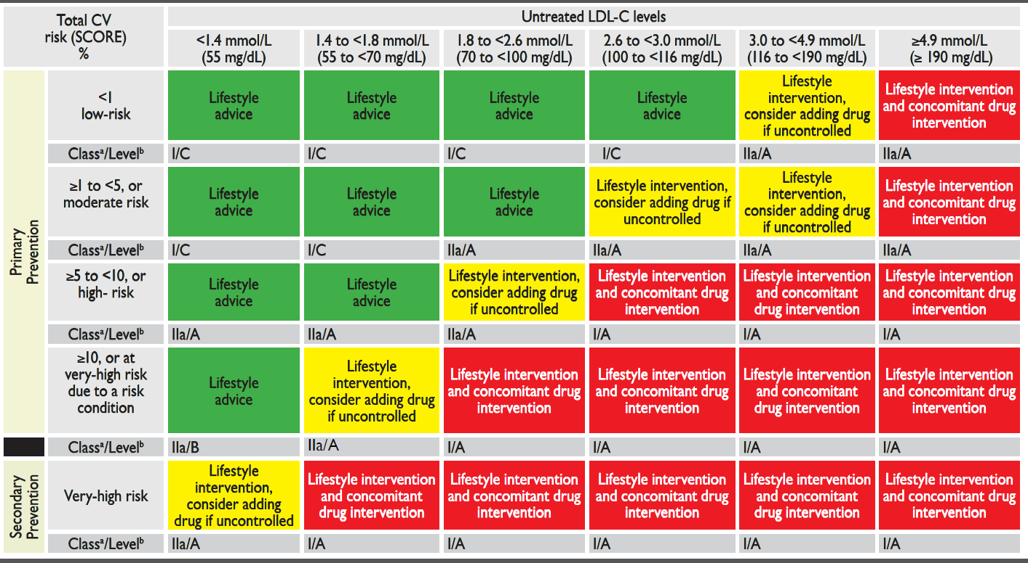
INTERVENTION STRATEGIES AS A FUNCTION OF TOTAL CARDIOVASCULAR RISK AND UNTREATED LOW-DENSITY LIPOPROTEIN CHOLESTEROL LEVELS (Table 5)
New category for secondary prevention without risk score
Mach F, et al. Eur Heart J. 2019; 0:1-78

Slide 17
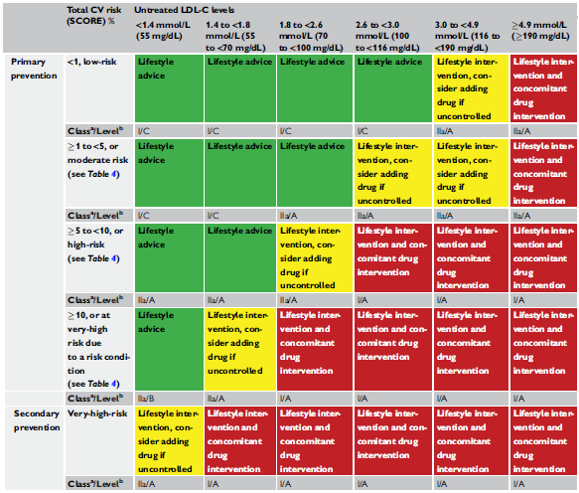
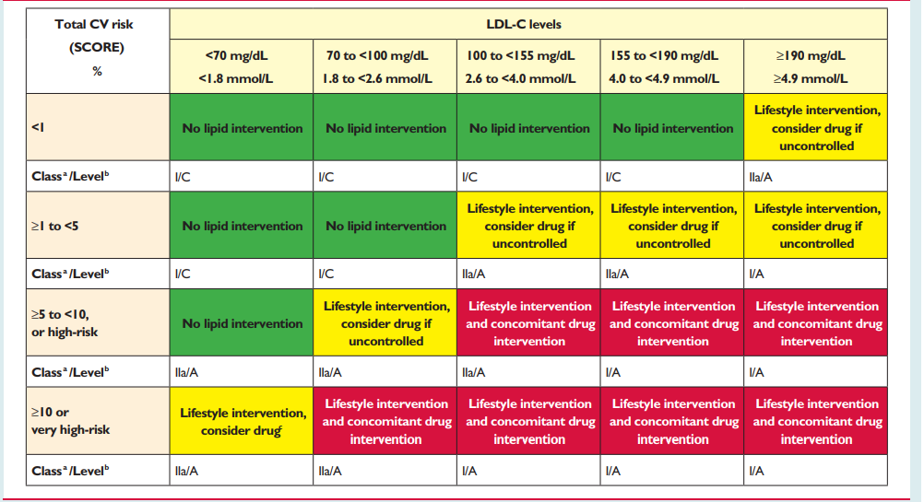
TABLE 5: 2016 vs 2019
2019
2016
Secondary prevention and primary prevention are well separated and well defined with specific emphasis on very high risk
Risk score not included for secondary prevention
LDL-C categories increased from 5 in 2016 to 6 in 2019 – ranging from 55 to 190 mg/dL - (1.4 to 4.9 mmol/L)
Catapano A, et al. Eur Heart J. 2016; 37, 2999-3058 - Mach F, et al. Eur Heart J. 2019; 0:1-78
Notes:
Secondary prevention and primary prevention are well separated and well defined with specific emphasis on very high risk
Risk score not included for secondary prevention
LDL-C categories changed (5 in 2016 and now 6 in 2019) – ranging from 55mg/dL to 190 mg/dL

Slide 18
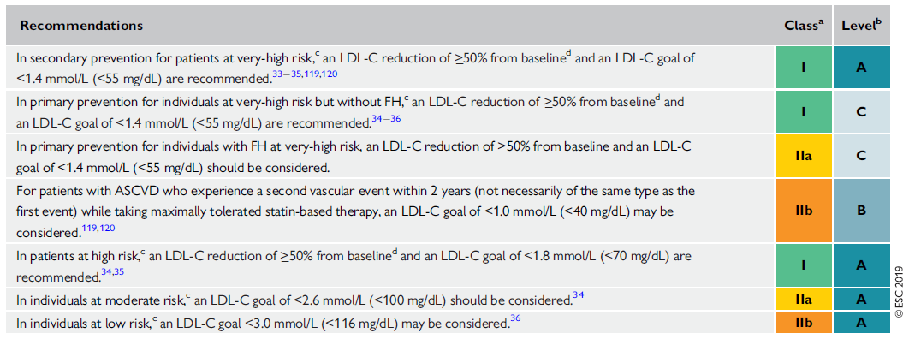
TREATMENT GOALS
New/Revised Concepts → Targets changed depending on CV risk :
Secondary prevention:
  ≥50% reduction AND target < 55mg/dL (1.4 mmol/L) (1A) & 40md/dL (< 1.0 mmol/L) ASCVD with second vascular event in 2 years on (IIb)
Primary prevention very high risk (w/o FH or w/o ASCVD):
  ≥50% reduction AND target < 55mg/dL (1.4 mmol/L) (1C)
Mach F, et al. Eur Heart J. 2019; 0:1-78

Slide 19
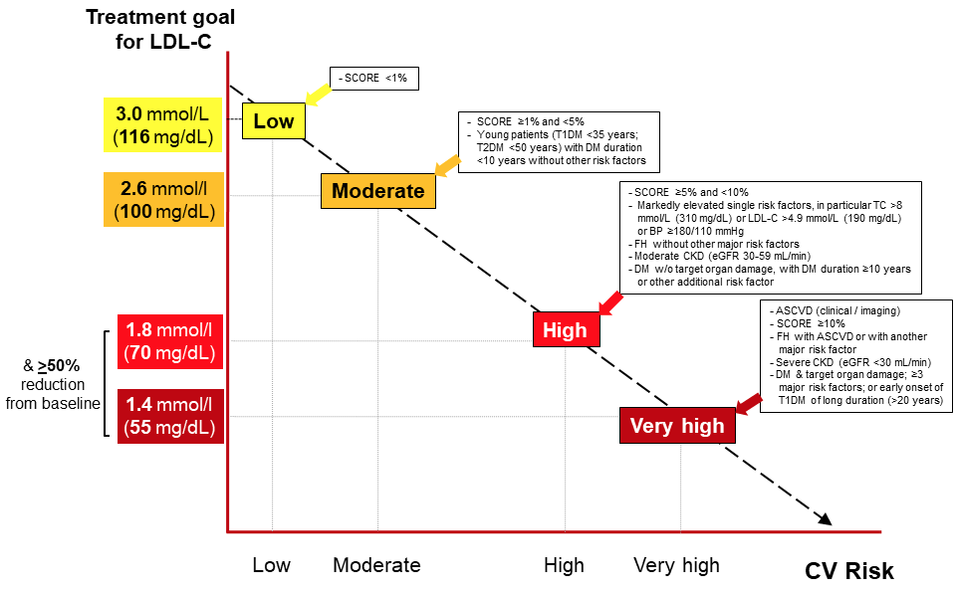
Treatment goals for low-density lipoprotein cholesterol (LDL-C) across categories of total cardiovascular disease risk
Mach F, et al. Eur Heart J. 2019; 0:1-78
Notes:
Summary slide

Slide 20
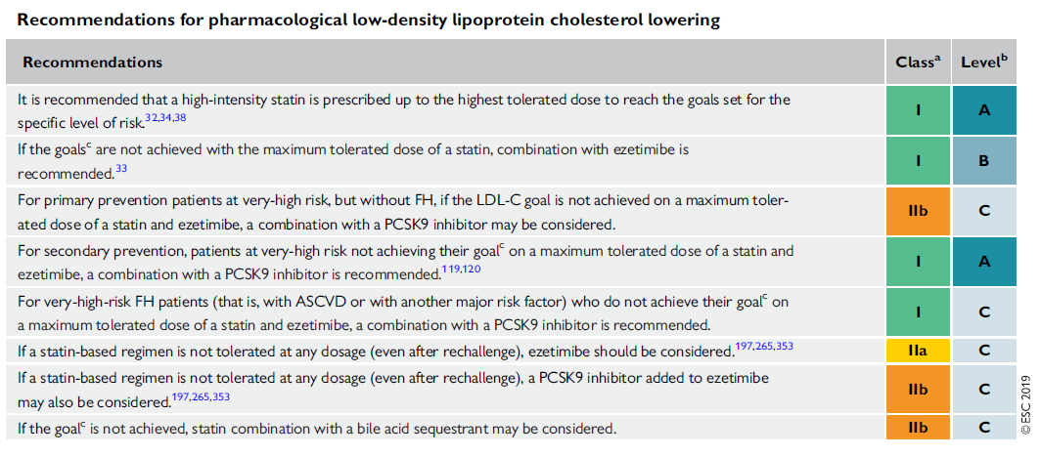
RECOMMENDATIONS FOR PHARMACOLOGICAL LDL-C LOWERING
Mach F, et al. Eur Heart J. 2019; 0:1-78
Notes:
Recommendations for pharmacological low-density lipoprotein cholesterol lowering

Slide 21
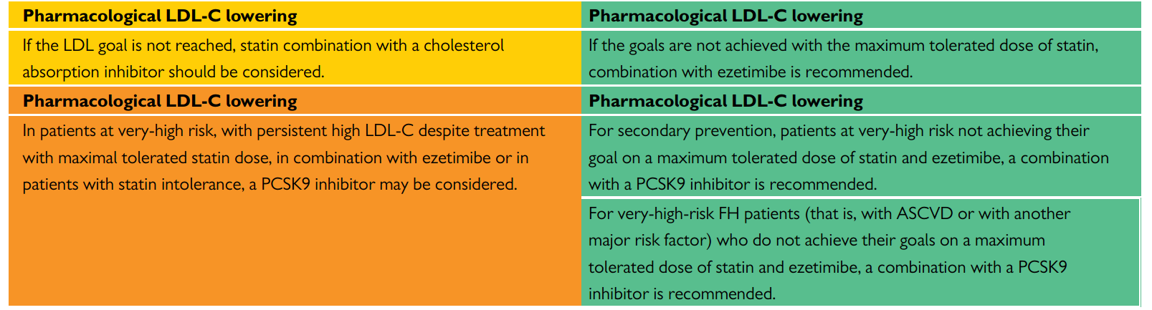
PHARMACOLOGICAL LDL-C LOWERING
2016
2019
Combination with ezetimibe is recommended
For secondary prevention (class IA) and very high risk FH (class IC);
PCSK9i RECOMMENDED
rather than may be considered.
2019 updated recommendations are based on the new outcome study data of PCSK9i.
Mach F, et al. Eur Heart J. 2019; 0:1-78 - Catapano A, et al. Eur Heart J. 2016; 37, 2999-3058
Notes:
PCSK9 recommended rather than may be considered for secondary prevention and very high risk FH.
New outcome study data of PCSK9 inhibitors are presented, and updated recommendations for their clinical use are provided.

Slide 22
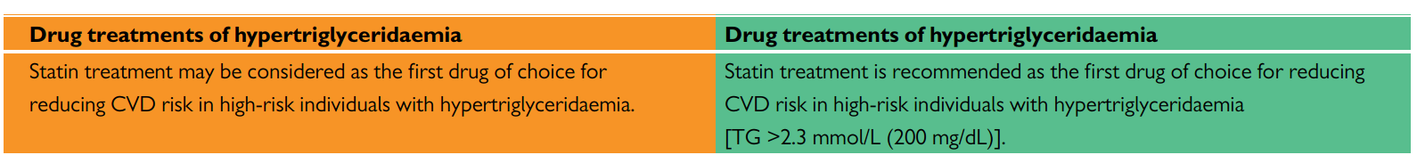
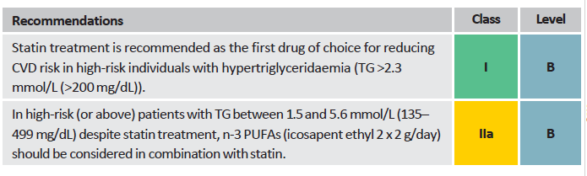
TREATMENT OF HYPERTRIGLYCERIDAEMIA
2016
2019
NEW
Mach F, et al. Eur Heart J. 2019; 0:1-78 - Catapano A, et al. Eur Heart J. 2016; 37, 2999-3058
Notes:
Icosapent ethyl, (Vascepa - 2x2 g/day), included based on REDUCE-IT trial

Slide 23
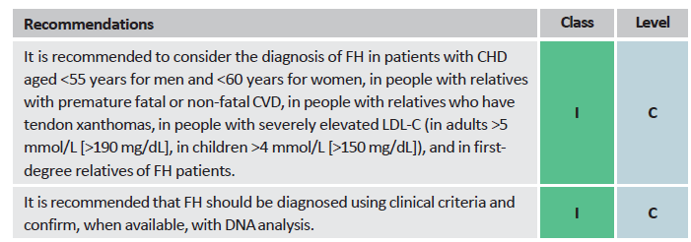
RECOMMENDATIONS FOR THE DETECTION AND TREATMENT OF PATIENTS WITH HETEROZYGOUS FAMILIAL HYPERCLOLESTEROLEMIA
Mach F, et al. Eur Heart J. 2019; 0:1-78

Slide 24
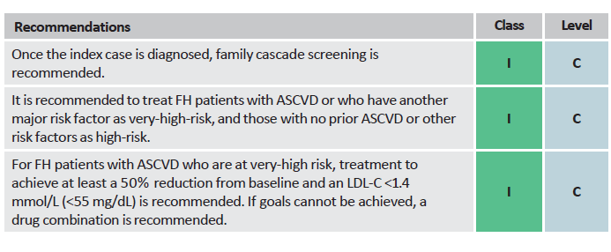
RECOMMENDATIONS FOR THE DETECTION AND TREATMENT OF PATIENTS WITH HETEROZYGOUS FAMILIAL HYPERCLOLESTEROLEMIA
Mach F, et al. Eur Heart J. 2019; 0:1-78

Slide 25
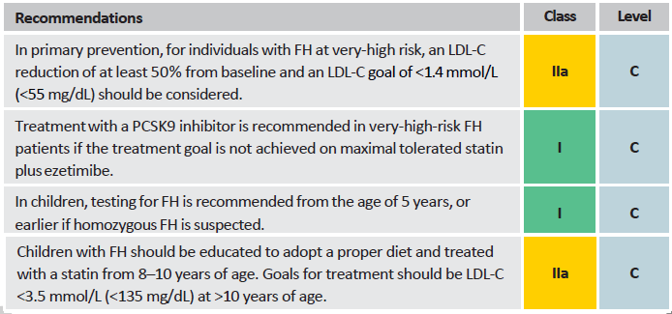
RECOMMENDATIONS FOR THE DETECTION AND TREATMENT OF PATIENTS WITH HETEROZYGOUS FAMILIAL HYPERCLOLESTEROLEMIA
NEW
Mach F, et al. Eur Heart J. 2019; 0:1-78

Slide 26
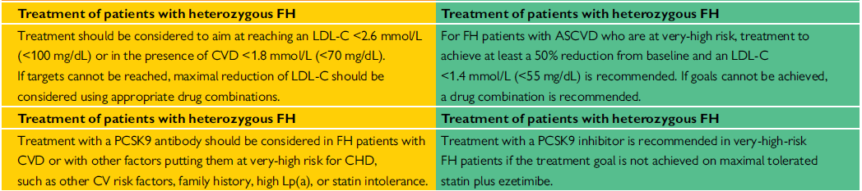
TREATMENT OF PATIENTS WITH HETEROZYGOUS FAMILIAL HYPERCHOLESTEROLEMIA
2016
2019
Therapy in HeFH pts
Class IIa-C to Class I-C
Targets decreased to < 55 mg/dL
Mach F, et al. Eur Heart J. 2019; 0:1-78 - Catapano A, et al. Eur Heart J. 2016; 37, 2999-3058
Notes:
New/revised concepts : Patients with FH and ASCVD, or another major risk factor, are classified as very-high-risk, and those without known ASCVD and without other risk factors as high-risk. Recommended treatment goals are defined accordingly.

Slide 27
RECOMMENDATIONS FOR LIPID-LOWERING THERAPY
IN VERY-HIGH-RISK PATIENTS WITH ACUTE CORONARY SYNDROME (ACS)
Recommendations
Class
Level
In all ACS patients without any contra-indication or definite history of intolerance, it is recommended to initiate or continue high dose statin as early as possible, regardless of initial LDL-C values.
I
A
Lipid levels should be re-evaluated 4–6 weeks after ACS to determine whether a reduction of at least 50% from baseline and goal levels of LDL-C <1.4 mmol/L (<55 mg/dL) have been achieved. Safety issues need to be assessed at this time and statin treatment doses adapted accordingly.
IIa
C
If the LDL-C goal is not achieved after 4–6 weeks with the maximally tolerated statin dose, combination with ezetimibe is recommended.
I
B
Mach F, et al. Eur Heart J. 2019; 0:1-78

Slide 28
RECOMMENDATIONS FOR LIPID-LOWERING THERAPY
IN VERY-HIGH-RISK PATIENTS WITH ACUTE CORONARY SYNDROME (ACS)
Recommendations
Class
Level
If the LDL-C goal is not achieved after 4–6 weeks despite maximal tolerated statin therapy and ezetimibe, adding a PCSK9 inhibitor is recommended.
I
B
In patients with confirmed statin intolerance or in patients in whom a statin is contra-indicated, ezetimibe should be considered.
IIa
C
For patients who present with an ACS and whose LDL-C levels are not at goal despite already taking a maximally tolerated statin dose and ezetimibe, adding a PCSK9 inhibitor early after the event (if possible, during hospitalization for the ACS event) should be considered.
IIa
C
Mach F, et al. Eur Heart J. 2019; 0:1-78

Slide 29
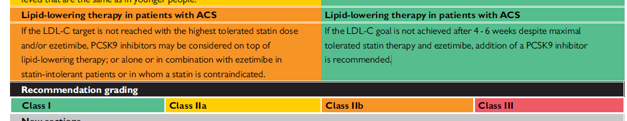
LIPID-LOWERING THERAPY IN PATIENTS WITH ACS
2016
2019
PCSK9i therapy in patients with ACS - class IIB to class IA
PCSK9i initiation in hospital should be considered for pts presenting with ACS already on MTD statin and ezetimibe – Class IIa
Mach F, et al. Eur Heart J. 2019; 0:1-78 –
Catapano A, et al. Eur Heart J. 2016; 37, 2999-3058

Slide 30
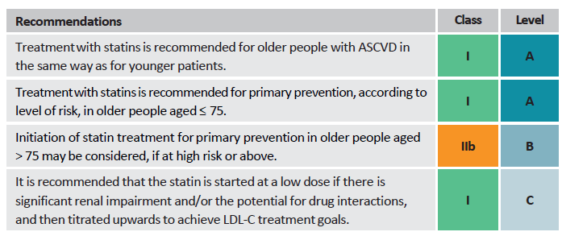
RECOMMENDATIONS FOR THE TREATMENT OD DYSLIPIDAEMIAS IN
OLDER PEOPLE AGED > 65 YEARS
NEW
Mach F, et al. Eur Heart J. 2019; 0:1-78

Slide 31
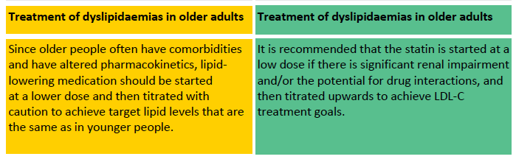
RECOMMENDATIONS FOR THE TREATMENT OF DYSLIPIDAEMIAS
IN OLDER ADULTS
2016
2019
Mach F, et al. Eur Heart J. 2019; 0:1-78
Catapano A, et al. Eur Heart J. 2016; 37, 2999-3058

Slide 32
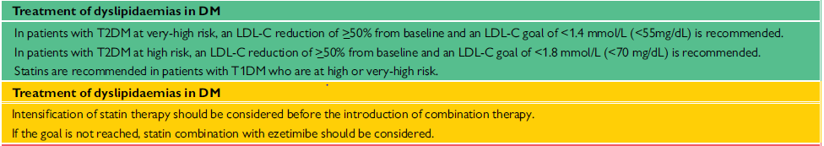
RECOMMENDATIONS FOR THE TREATMENT OF DYSLIPIDAEMIAS
IN DIABETES
NEW
Very high risk targets < 55 mg/dL
High risk target < 70 mg/dL
Mach F, et al. Eur Heart J. 2019; 0:1-78

Slide 33
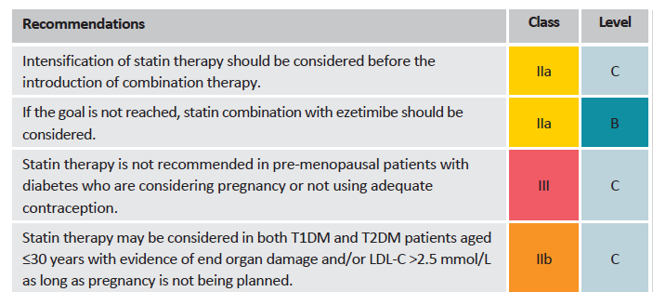
RECOMMENDATIONS FOR THE TREATMENT OF DYSLIPIDAEMIAS
IN DIABETES
NEW
Mach F, et al. Eur Heart J. 2019; 0:1-78

Slide 34
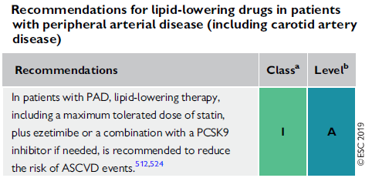
RECOMMENDATIONS FOR THE TREATMENT OF DYSLIPIDAEMIAS
WITH PAD
In patients with PAD,
a combination of LLT with a PCSK9i if needed,
Is RECOMMENDED
Mach F, et al. Eur Heart J. 2019; 0:1-78

Slide 35
TREATMENT ALGORITHM FOR PHARMACOLOGICAL LDL-C LOWERING
Total CV risk assessment
In selected low- and moderate-risk patients
Baseline LDL-C levels
Risk modifiers imaging (subclinical atherosclerosis) Risk Reclassification?
Indication for drug therapy?
Define treatment goal
Lifestyle advice/ Lifestyle intervention
High potency statin at highest
recommended/ tolerable dose to reach the goal
LDL-C goal reached?
New ESC/EAS 2019 Guidelines Acknowledge Statin/Ezetimibe as Step #2 Combination Therapy
Follow-up
Add ezetimibe
Annually, or more frequency
if indicated
LDL-C goal reached?
Secondary prevention (very-high-risk)
Primary prevention patients with FH and another major risk factor (very-high-risk)
Follow-up Annually, or more frequency
if indicated
Add PCSK9 inhibitor
Consider adding PCSK9 inhibitor
Primary prevention patients at very-high risk but without FH
Mach F, et al. Eur Heart J. 2019; 0:1-78
14

Slide 36
Expected clinical benefit of
LDL -C lowering therapies
Intensity of lipid-lowering treatment
Treatment
Moderate-intensity statin High-intensity statin
Average LDL-C reduction
≈ 30%
≈ 50%
High-intensity statin plus ezetimibe
≈ 65%
PCSK9 inhibitor
≈ 60%
PCSK9 inhibitor plus high-intensity statin
PCSK9 inhibitor plus high-intensity statin plus ezetimibe
≈ 75%
≈ 85%
% reduction LDL-C
Baseline LDL-C
Absolute reduction LDL-C
Relative risk reduction
Baseline risk
Absolute risk reduction
Mach F, et al. Eur Heart J. 2019; 0:1-78
LDL-C = low density lipoprotein cholesterol
PCSK9 = proprotein convertase subtilisin/kexin type 9

Slide 37
ALGORITHM FOR THE TREATMENT OF MUSCULAR SYMPTOMS
DURING STATIN TREATMENT
Consider if statin-attributed muscle symptoms favour statin continuation/reinitiation
Symptomatic & CK <4 X ULN CK ≥4 X ULN Rhabdomyolysis
2-4 weeks washout of statin
6 weeks washout of statin until normalisation of CK and symptoms
Symptoms persist:
Statin re-challenge
Check for other causes
of muscular symptoms
Symptoms improve: Second statin at usual or
starting dose
Low-dose third efficacious (potent) statin
Efficacious statin with alternate day or once/twice weekly dosing regimen
Symptoms re-occur
Low-dose third efficacious (potent) statin
Efficacious statin with alternate day or once/twice weekly dosing regimen
AIM: Achieve LDL-C goal with maximally tolerated dose of statin
Add a PCSK9 inhibitor
I/A recommendation for secondary prevention patients (very high risk)
I/C recommendation for primary prevention FH patients
with another major risk factor (very-high risk)
IIb/C recommendation for primary prevention in individuals at very high-risk but without FH)
Add ezetimibe
Consider adding bile acid sequestrant
IIb/C recommendation
Mach F, et al. Eur Heart J. 2019; 0:1-78
15
CK, creatine kinase; PCSK9, proprotein convertase subtilisin/kexin type 9; ULN, upper limit of normal

Slide 38
Treatment goals for low-density lipoprotein cholesterol (LDL-C) across categories of total cardiovascular disease risk
Mach F, et al. Eur Heart J. 2019; 0:1-78
Notes:
Summary slide

Slide 39
TAKE HOME MESSAGE
The new ESC/EAS 2019 dyslipidaemia guidelines propose, based on recent studies, a CV-risk-based approach and recommend new LDL-C goals, which are especially relevant to High- and Very-High-Risk patients
Based on new data, the recommendation for a stepwise approach has been strengthened
LDL-C management remains a key approach to reduce CVD events
More stringent LDL-C thresholds should be achieved in patients from Moderate to High to Very High CV risk (“the more CV risk goes up, the more LDL must come down”)
  The “treat to target” approach utilized in ODYSSEY OUTCOMES supports the new LDL-C goal:
    LDL-C goal of <1.4 mmol/L or <55 mg/dL for Very High Risk (VHR) patients (secondary and primary prevention)
    LDL-C goal of <1.0 mmol/L or <40 mg/dL for patients who experience a second vascular event within 2 years while taking maximally tolerated statin-based therapy

Slide 40
TAKE HOME MESSAGE
Intensification of LDL-lowering therapy should be pursued and based on:
  CV risk, irrespective of its underlying cause
  Baseline LDL-C
New Guidelines implementation in real life: a stepwise approach
  Use High-Intensity statin monotherapy for any specific level of CV risk
  Acknowledge statin-ezetimibe combination as step #2 if LDL goal is not achieved, based on:
strong expected clinical benefits (~65% LDL-C reduction)
high cost-effectiveness in reducing both LDL-C and CVD risk
  Add PCSK9-Inhibitors as step #3 if LDL goal still not achieved
PCSK9i are now officially recommended for clinical practice use in secondary prevention patients not at goal on MTD statin and ezetimibe, based on the strongest level of evidence possible (Class IA Recommendation)
Strong emphasis on the urgency to treat ACS patients (ODYSSEY OUTCOMES trial population) and the necessity to intensify lipid lowering treatment sooner after the ACS event including PCSK9i.

Slide 41
A Deep Dive into the
New 2019 ESC/EAS Guidelines
for the management of Dyslipidaemias:
lipid modification to reduce cardiovascular risk
DEEL II:
Van theorie naar praktische oefening
Ontwikkeld in samenwerking met Prof. dr. G De Backer - UGent
www.escardio.org/guidelines
2019 ESC/EAS Guidelines for the management of dyslipidaemias: lipid modification to reduce cardiovascular risk - Adapted from Mach F, et al. European Heart Journal 2019; 1-78

Slide 42
Casus 1

Slide 43
Casus 1: Patiënt MW
Patiënt gegevens
Demografie | 60-jaar, vrouw, blank, lagere economische klasse
Reden voor consultatie | moeheid
Klinische/ familiale geschiedenis | Ongerust over het plots overlijden van haar broer op de leeftijd van 62 jaar
CV risico factoren | Nooit gerookt; fysiek inactief; 86 Kg, BMI 30 Kg/m²; buikomtrek = 88 cm; BD: 120/76 mmHg
Lipiden profiel | TC = 270 mg/dL, TGs = 250 mg/dL,
Laboratorium | Haemoglobine= 13,6 g/L
CV, cardiovasculair; TC, totaal cholesterol; TG, triglyceride, BD, bloeddruk; BMI, body mass index

Slide 44
Polling vraag
Wat is haar 10 jaar risico op een fatale CVZ?
Laag
Matig
Verhoogd
Sterk verhoogd
Patiënt gegevens
Demografie | 60-jaar, vrouw, blank, lagere economische klasse
Reden voor consultatie | moeheid
Klinische/ familiale geschiedenis | Ongerust over het plots overlijden van haar broer op de leeftijd van 62 jaar
CV risico factoren | Nooit gerookt; fysiek inactief; 86 Kg, BMI 30 kg/m²; buikomtrek = 88 cm; BD: 120/76 mmHg
Lipiden profiel | TC = 270 mg/dL, TGs = 250 mg/dL,
Laboratorium | Haemoglobine= 13,6 g/L

Slide 45
SCORE chart for European populations at low
cardiovascular disease risk
SCORE Cardiovascular Risk Chart
10-year risk of fatal CVD
Low-risk regions of Europe
Systolic blood pressure (mmHg)
WOMEN
MEN
Non-smoker
Smoker
Age
Non-smoker
Smoker
180 | 2 | 3 | 3 | 3 | 4 | 5 | 5 | 6
160 | 2 | 2 | 2 | 2 | 3 | 3 | 4 | 4
140 | 1 | 1 | 1 | 2 | 2 | 2 | 3 | 3
120 | 1 | 1 | 1 | 1 | 2 | 2 | 2 | 2
 | 4 | 5 | 6 | 7 | 4 | 5 | 6 | 7
5 | 6 | 7 | 8 | 8 | 10 | 11 | 13
4 | 4 | 5 | 5 | 6 | 7 | 8 | 9
3 | 3 | 3 | 4 | 4 | 5 | 6 | 7
2 | 2 | 2 | 3 | 3 | 4 | 4 | 5
4 | 5 | 6 | 7 | 4 | 5 | 6 | 7
60
Total cholesterol (mmol/L) x 38,67 = mg/dL
 | <3% |  | 3-4% |  | 5-9% |  | ≥10%
45

Slide 46
Casus 1: Patiënt MW - Totaal CV risico inschatting
Nooit gerookt, BD: 120/76 mmHg, TC 270 mg/dL
Totaal CV risico:
- SCORE internationaal 2003, laag risico landen: 1%/10jr
- SCORE gecalibreerd voor België 2003 : 1%/10jr
- HeartScore met HDL-C 56 mg/dL : 1%/10/jr
- SCORE internationaal, laag risico landen, 2019, leeftijd interactie meegerekend: 1%/10jr

Slide 47
Polling vraag
Wat is haar 10 jaar risico op een fatale CVZ?
Laag
Matig
Verhoogd
Sterk verhoogd
FH, familial hypercholesterolaemia; Lp(a), lipoprotein(a)

Slide 48
Casus 1: Patiënt MW - Totaal CV risico inschatting
Zult U
(a) Meteen een statine voorschrijven gelet op het totaal cholesterol van 270 mg/dL?
(b) Voedingsadvies geven voor 6 maand en dan herbekijken?
(c) Andere aspecten nakijken?

Slide 49
Recommendations for lipid analyses for
cardiovascular disease risk estimation (1)
Recommendations | Class | Level
TC is to be used for the estimation of total CV risk by means of the SCORE system. | I | C
HDL-C analysis is recommended to further refine risk estimation using the online SCORE system (www.Heartscore.org) | I | C
LDL-C analysis is recommended as the primary lipid analysis for screening, diagnosis and management. | I | C
TG analysis is recommended as a part of the routine lipid analysis. | I | C

Slide 50
Recommendations for lipid analyses for
cardiovascular disease risk estimation (2)
Recommendations | Class | Level
Non-HDL-C evaluation is recommended for risk assessment, particularly in people with high TG, diabetes, obesity or very low LDL-C. | I | C
ApoB analysis is recommended for risk assessment, particularly in people with high TG, diabetes, obesity or metabolic syndrome, or very low LDL-C. It can be used as an alternative to LDL-C, if available, as the primary measurement for screening, diagnosis and management, and may be preferred over non-HDL-C in people with high TG, diabetes, obesity or very low LDL-C. | I | C

Slide 51
Recommendations for lipid analyses for
cardiovascular disease risk estimation (3)
Recommendations | Class | Level
Lp(a) measurement should be considered at least once in each adult person’s lifetime to identify those with very high inherited Lp(a) levels >180 mg/dL (>430 nmol/L) who may have a lifetime risk of ASCVD equivalent to the risk associated with heterozygous familial hypercholesterolaemia. | IIa | C
Lp(a) should be considered in selected patients with a family history of premature CVD, and for reclassification in people who are borderline between moderate and high-risk. | IIa | C

Slide 52
Casus 1: Patiënt MW
Patiënt gegevens
Demografie | 60-jaar, vrouw, blank, lagere economische klasse
Reden voor consultatie | moeheid
Klinische/ familiale geschiedenis | Ongerust over het plots overlijden van haar broer op de leeftijd van 62 jaar
CV risico factoren | Nooit gerookt; fysiek inactief; 86 Kg, BMI 30 kg/m²; buikomtrek = 88 cm; BD: 120/76 mmHg
Lipiden profiel | TC = 270 mg/dL, TGs = 250 mg/dL,
Laboratorium | Haemoglobine= 13,6 g/L
Volledig lipiden profiel beschikbaar:
LDL-C = 164 mg/dL, HDL-C = 56 mg/dL, NON-HDL-C = 214 mg/dL, Lp(a) = 30 mg/dL
CV, cardiovasculair; HDL-C, high-density lipoprotein cholesterol; LDL-C, low-density lipoprotein cholesterol; TG, triglyceride; Lp(a), lipoprotein a

Slide 53
Casus 1: Patiënt MW
Serumlipiden variëren! Herhaal een volledig lipidenprofiel
(nuchtere toestand niet noodzakelijk).
Ze is moe en obees. Hypothyreose moet als oorzaak van de dyslipidemie worden uitgesloten.
Vrouwen met één enkele CV risicofactor zijn slecht vertegenwoordigd in klinische trials.
Haar totaal CV risico wordt als laag tot matig ingeschat.
→ Het lijkt redelijk om eerst aanpassing van leefgewoonten aan te bevelen alvorens een statine te starten.

Slide 54
Intervention strategies as a function of total cardiovascular risk and untreated low-density lipoprotein cholesterol levels

Slide 55
Total CV risk (SCORE)% | Untreated LDL-C levels
 | <1.4 mmol/L (55 mg/dL) | 1.4 to <1.8 mmol/L (55 to <70 mg/dL) | 1.8 to <2.6 mmol/L (70 to <100 mg/dL) | 2.6 to <3.0 mmol/L (100 to <116 mg/dL) | 3.0 to <4.9 mmol/L (116 to <190 mg/dL) | ≥4.9 mmol/L (≥190 mg/dL)
Primary Prevention
< 1 Low-risk | Lifestyle advice | Lifestyle advice | Lifestyle advice | Lifestyle advice | Lifestyle intervention, consider adding drug if uncontrolled | Lifestyle Intervention and concomitant drug intervention
Classª/Level^{b} | I/C | I/C | I/C | I/C | IIa/A | IIa/A
≥1 to <5, or moderate risk (see Table 1) | Lifestyle advice | Lifestyle advice | Lifestyle advice | Lifestyle intervention, consider adding drug if uncontrolled | Lifestyle intervention, consider adding drug if uncontrolled | Lifestyle Intervention and concomitant drug intervention
Classª/Level^{b} | I/C | I/C | IIa/A | IIa/A | IIa/A | IIa/A
©ESC

Slide 56
Casus 1: Conclusies
* Aanpassing van leefgewoonten:
Voeding: Een evenwichtige voeding arm aan verzadigd vet en meer volle graanproducten, fruit, groenten en vis.
Fysieke activiteit: 2.5 - 5u matig intense fysieke activiteiten per week of 30 - 60 min. elke dag.
* Streefwaarden : BMI 20–25 kg/m², buikomtrek < 80 cm.
LDL-C : < 100 mg/dL
→ Indien LDL-C niet onder controle komt met aanpassingen van leefgewoonten alleen, is een behandeling met statines te overwegen,
in overleg met de patiënt.

Slide 57
Casus 2

Slide 58
Casus 2: Patiënt SR
Patiënt gegevens
Demografie | 46-jaar, man, blank, werkt als taxi-chauffeur in Brussel
Reden voor consultatie | luchtweginfectie
Klinische/ familiale geschiedenis | Niet gekend
CV risico factoren | Rookt 25 cigaretten/dag, hypertensie, BD 160 mmg/Hg, BMI 31Kg/m², buikomtrek = 118 cm
Lipiden profiel | TC = 270 mg/dL, HDL-C = 39 mg/dL
Outcome | Longen klinisch vrij; Patiënt is akkoord om de gelegenheid te gebruiken om zijn totaal CV risico te schatten
CV, cardiovascular; TC, total cholesterol; HDL-C, high-density lipoprotein cholesterol; BD, bloeddruk

Slide 59
Polling vraag
Wat is zijn 10 jaar risico op een fatale CVZ?
Laag
Matig
Verhoogd
Sterk verhoogd
Patiënt gegevens
Demografie | 46-jaar, man, blank, werkt als taxi-chauffeur in Brussel
Reden voor consultatie | luchtweginfectie
Klinische/ familiale geschiedenis | Niet gekend
CV risico factoren | Rookt 25 cigaretten/dag, hypertensie, BD 160 mmg/Hg, BMI 31Kg/m², buikomtrek = 118 cm
Lipiden profiel | TC = 270 mg/dL, HDL-C = 39 mg/dL
Outcome | Longen klinisch vrij; Patiënt is akkoord om de gelegenheid te gebruiken om zijn totaal CV risico te schatten

Slide 60
SCORE chart for European populations at low cardiovascular disease risk
SCORE Cardiovascular Risk Chart
10-year risk of fatal CVD
Low-risk regions of Europe
Systolic blood pressure (mmHg)
WOMEN
MEN
Non-smoker
Smoker
Age
Non-smoker
Smoker
180 | 0 | 0 | 0 | 0 | 1 | 1 | 1 | 1
160 | 0 | 0 | 0 | 0 | 0 | 0 | 0 | 1
140 | 0 | 0 | 0 | 0 | 0 | 0 | 0 | 0
120 | 0 | 0 | 0 | 0 | 0 | 0 | 0 | 0
 | 4 | 5 | 6 | 7 | 4 | 5 | 6 | 7
1 | 1 | 1 | 1 | 2 | 2 | 3 | 3
0 | 0 | 1 | 1 | 1 | 1 | 1 | 2
0 | 0 | 0 | 0 | 1 | 1 | 1 | 1
0 | 0 | 0 | 0 | 0 | 0 | 0 | 1
4 | 5 | 6 | 7 | 4 | 5 | 6 | 7
40
Total cholesterol (mmol/L) x 38,67 = mg/dL
 | <3% |  | 3-4% |  | 5-9% |  | ≥10%

Slide 61
Polling vraag
Wat is zijn 10 jaar risico op een fatale CVZ?
Laag
Matig
Verhoogd
Sterk verhoogd
Risico volgens het 2019 SCORE model- laag risico landen 1-2 %/10 jr
Zou dit een onderschatting kunnen zijn?
FH, familial hypercholesterolaemia; Lp(a), lipoprotein(a)

Slide 62
Casus 2: Patiënt SR - Is zijn totaal CV risico van 1-2 % mogelijk een onderschatting?
JA omdat:
Hij is 46 jaar oud, niet 40 jaar
Hij heeft een TC van 270 mg/dL, niet 240
Hij heeft een HDL-C van slechts 39 mg/dL
What next?
Hou rekening met andere risicofactoren

Slide 63
Casus 2 : Patiënt SR: Andere Risicofactoren?
De electronische versie van SCORE, HeartScore, laat toe de exacte cijfers van total cholesterol, BD en leeftijd in te brengen evenals het HDL-C.
Met HeartScore, bedraagt zijn risico niet 1 % maar 3% /10jr
www.Heartscore.org
Andere risicofactoren ?

Slide 64
Factoren die SCORE-risico kunnen wijzigen
- Sociale klasse
- Obesitas en centrale obesitas - Fysieke inactiviteit
- Psychosociale stress
- Familiale voorgeschiedenis van premature CVZ ( man < 55 jr; vrouw < 60 jr)
- Ernstige geestesziekten
- Chronische immuun-gemedieerde inflammatoire ziekten
- Behandeling voor HIV infectie
- Obstructieve slaap apnoe syndroom
- Andere lipiden parameters : Lp(a), HDL-C, TG,
Notes:
Referentie toevoegen

Slide 65
Factoren die SCORE-risico kunnen wijzigen - Mr. SR
- Sociale klasse JA
- Obesitas en centrale obesitas JA - Fysieke inactiviteit JA
- Psychosociale stress NEEN
- Familiale voorgeschiedenis van premature CVZ ( man < 55 jr; vrouw < 60 jr) JA, zijn vader overleed tgv een AMI op 49 jaar
- Ernstige geestesziekten NEEN
- Chronische immuun-gemedieerde inflammatoire ziekten NEEN
- Behandeling voor HIV infectie NEEN
- Obstructieve slaap apnoe syndroom NEEN
- Andere lipiden parameters : Lp(a), HDL-C, TG, JA, HDL-C 39 mg/dL

Slide 66
Rekening houdend met het resultaat van HeartScore (3%/10 jr) en met de andere risicofactoren ( lagere sociale klasse, obesitas en centrale obesitas, fysieke inactiviteit, een laag HDL-C en een positieve familiale voorgeschiedenis) is zijn totaal CV risico meer dan 5%/10 jr.
Hoe gaan we hem verder adviseren?
Casus 2: Patiënt SR

Slide 67
Relatief Risico Kaart
Deze kaart kan gebruikt worden om er op te wijzen dat het totale CV risico van een persoon flink verhoogd is. Dit kan helpen om hen te motiveren leefgewoonten te wijzigen en/of de nood aan medicatie te overwegen. In het geval van Mr SR. is zijn relatief risico 7 x groter dan dit van een man van dezelfde leeftijd die niet rookt, een SBD heeft van <140 mmHg en een TC van < 200 mg/dL
X 38,67 = mg/dL

Slide 68
Leeftijd volgens risicoprofiel
Definitie:
„De leeftijd van een persoon met risicofactoren wordt vergeleken
met die van een persoon met ideaal risicoprofiel. De persoon met de
risicofactoren heeft de cardiovasculaire leeftijd van de persoon
met ideaal risicoprofiel.”
Synoniem:
Cardiovasculaire leeftijd

Slide 69
10-year risk of fatal CVD (1)
Low-risk regions of Europe (age interactions included)
WOMEN
MEN
 | Non-smoker |  |  |  | Smoker |  |  |  | Age | Non-smoker |  |  |  | Smoker
180 | 7 | 8 | 8 | 9 | 11 | 11 | 12 | 13 |  | 12 | 14 | 15 | 17 | 18 | 20 | 22 | 24
160 | 6 | 6 | 7 | 7 | 9 | 9 | 10 | 11 | 70 | 10 | 11 | 13 | 14 | 15 | 16 | 18 | 20
140 | 5 | 5 | 6 | 6 | 7 | 8 | 8 | 9 |  | 8 | 9 | 10 | 12 | 12 | 13 | 15 | 17
120 | 4 | 4 | 5 | 5 | 6 | 6 | 7 | 7 |  | 7 | 8 | 9 | 10 | 10 | 11 | 12 | 14
180 | 4 | 4 | 5 | 5 | 7 | 7 | 8 | 9 |  | 8 | 9 | 10 | 12 | 12 | 14 | 16 | 18
160 | 3 | 3 | 4 | 4 | 5 | 6 | 6 | 7 | 65 | 6 | 7 | 8 | 9 | 9 | 11 | 12 | 14
140 | 2 | 3 | 3 | 3 | 4 | 4 | 5 | 5 |  | 5 | 5 | 6 | 7 | 7 | 8 | 9 | 11
120 | 2 | 2 | 2 | 2 | 3 | 3 | 3 | 4 |  | 3 | 4 | 5 | 5 | 5 | 6 | 7 | 8
180 | 2 | 3 | 3 | 3 | 4 | 5 | 5 | 6 |  | 5 | 6 | 7 | 8 | 8 | 10 | 11 | 13
160 | 2 | 2 | 2 | 2 | 3 | 3 | 4 | 4 | 60 | 4 | 4 | 5 | 5 | 6 | 7 | 8 | 9
140 | 1 | 1 | 1 | 2 | 2 | 2 | 3 | 3 |  | 3 | 3 | 3 | 4 | 4 | 5 | 6 | 7
120 | 1 | 1 | 1 | 1 | 2 | 2 | 2 | 2 |  | 2 | 2 | 2 | 3 | 3 | 4 | 4 | 5
180 | 1 | 1 | 2 | 2 | 3 | 3 | 3 | 4 |  | 3 | 4 | 4 | 5 | 6 | 7 | 8 | 9
160 | 1 | 1 | 1 | 1 | 2 | 2 | 2 | 3 | 55 | 2 | 2 | 3 | 3 | 4 | 4 | 5 | 6
140 | 1 | 1 | 1 | 1 | 1 | 1 | 1 | 2 |  | 1 | 2 | 2 | 2 | 3 | 3 | 3 | 4
120 | 0 | 0 | 0 | 1 | 1 | 1 | 1 | 1 |  | 1 | 1 | 1 | 2 | 2 | 2 | 2 | 3
180 | 1 | 1 | 1 | 1 | 2 | 2 | 2 | 3 |  | 2 | 2 | 3 | 3 | 4 | 5 | 5 | 6
160 | 0 | 0 | 1 | 1 | 1 | 1 | 1 | 2 | 50 | 1 | 1 | 2 | 2 | 2 | 3 | 3 | 4
140 | 0 | 0 | 0 | 0 | 1 | 1 | 1 | 1 |  | 1 | 1 | 1 | 1 | 1 | 2 | 2 | 3
120 | 0 | 0 | 0 | 0 | 0 | 0 | 0 | 1 |  | 0 | 1 | 1 | 1 | 1 | 1 | 1 | 2
180 | 0 | 0 | 0 | 0 | 1 | 1 | 1 | 1 |  | 1 | 1 | 1 | 1 | 2 | 2 | 3 | 3
160 | 0 | 0 | 0 | 0 | 0 | 0 | 0 | 1 | 40 | 0 | 0 | 1 | 1 | 1 | 1 | 1 | 2
140 | 0 | 0 | 0 | 0 | 0 | 0 | 0 | 0 |  | 0 | 0 | 0 | 0 | 1 | 1 | 1 | 1
120 | 0 | 0 | 0 | 0 | 0 | 0 | 0 | 0 |  | 0 | 0 | 0 | 0 | 0 | 0 | 0 | 1
 | 4 | 5 | 6 | 7 | 4 | 5 | 6 | 7 |  | 4 | 5 | 6 | 7 | 4 | 5 | 6 | 7
Systolic blood pressure (mmHg)
Illustration of the risk age concept
Het risico van deze 46 -jarige roker met andere risico factoren is hetzelfde (2%) als dat van een 60-jarige man met een optimaal risicoprofiel - daarom is zijn cardiovasculaire leeftijd 60 jaar
 | <3% |  | 3-4% |  | 5-9% |  | ≥10%
Total cholesterol (mmol/L) x 38,67 = mg/dL
©ESC

Slide 70
Casus 2: Patiënt SR
Zijn relatief risico is minstens x7 en zijn cardiovasculaire leeftijd minstens
60 jr. in plaats van 46
Zijn absoluut totaal CV risico is > 5% /10 jr volgens HeartScore en andere risicofactoren
Relatief risico en cardiovasculaire leeftijd zijn nuttig om het risico te illustreren maar niet om beslissingen te nemen over behandeling
Op basis van zijn absoluut CV risico zult U hem wijzigingen van leefwijze voorstellen en antihypertensieve en hypolipemiërende medicatie overwegen.
Overweegt U:
- Screening naar subklinische atherosclerose?
- Genetische tests voor FH?

Slide 71
Casus 2: CT calcium of genetische tests?
Screening naar subklinische atherosclerose kan nuttig zijn om personen met een matig verhoogd totaal CV risico te herklassificeren, maar voor Mr SR. is dat niet nodig aangezien zijn totaal CV risico hoe dan ook reeds verhoogd is wat intensieve preventieve actie nodig maakt.
Genetische tests voor FH zal het beleid wellicht niet wijzigen – maar alle eerste-graad familieleden van Mr SR. worden aanbevolen hun risicoprofiel te laten bepalen in het bijzonder het lipidenprofiel (cascade screening)

Slide 72
Casus 2: Conclusies
Primaire preventie van CVZ moet gestuurd worden door het totale CV risico van de patiënt. Maar de inschatting ervan is geen exacte wetenschap en blijft op individueel vlak riskant. Het laat toe de bevolking in te delen in groepen met een verschillend risicoprofiel. HeartScore kan de inschatting preciezer maken en andere CV risicofactoren moeten ook in overweging worden genomen.
Relatief risico en cardiovasculaire leeftijd kunnen nuttig zijn voor communicatie maar hebben weinig waarde bij beslissingen over medicamenteuze behandeling.
Beslissingen omtrent medicamenteuze behandelingen moeten steunen op resultaten van klinische studies met het absolute risico aan de basis.
Screening naar subklinische atherosclerose kan de risico inschatting verbeteren bij personen met een matig verhoogd SCORE risicoprofiel maar zal het beleid niet wijzigen bij personen met een verhoogd SCORE risico

Slide 73
Casus 3

Slide 74
Casus 3: Patiënt IG
Patiënt gegevens
Demografie | 52-jaar, man
Klinische/familiale geschiedenis | NSTEMI 6 maand geleden
CV risico factoren | Rookt sind 30 jaar, hypertensie, hypercholesterolaemie (niet adequaat behandeld)
Lipiden profiel | LDL-C = 140 mg/dL, HDL-C = 50 mg/dL, TGs = 70 mg/dL
Behandeling | Atorvastatine 80 mg/dag
Uitkomst | LDL-C = 70 mg/dL
Follow-up | Spierpijn 3 maanden na start van statine behandeling, CK 520 U/L (normal CK range: 22–198 U/L)
Wat zijn de uitdagingen van deze casus?
Moet u stoppen met de behandeling met atorvastatine?
Zo ja, welk ander lipidenverlagend medicijn zou u voorschrijven?
Welke dosis?
Hoe zou u de dosis verhogen?
Zou u combinatietherapie overwegen? Zo ja, Welke?
CK, creatine kinase; CV, cardiovasculair; HDL-C, high-density lipoprotein cholesterol; LDL-C, low-density lipoprotein cholesterol; NSTEMI, non-ST segment elevation myocardial infarction; TG, triglyceride

Slide 75
Statine intolerantie
Veel patiënten behandeld met statines halen de LDL-C-streefwaarden niet.
De belangrijkste oorzaak voor statine-intolerantie zijn bijwerkingen.
Bijwerkingen zijn
- over het algemeen tijdelijk gerelateerd aan het gebruik van statines,
- verbeteren wanneer het statine wordt gestopt en
- komen terug wanneer het statine opnieuw wordt gestart
Statine-intolerantie is niet zeldzaam, met een frequentie van bijna 10-20% (volgens sommige auteurs)
Waarom?
- Meer patiënten komen voor statine in aanmerking
- Verhoogd gebruik van hoge doses statines
LDL-C, low density lipoprotein
Reiner Ž. Nutr Metab Cardiovasc Dis. 2014;24:1057–66

Slide 76
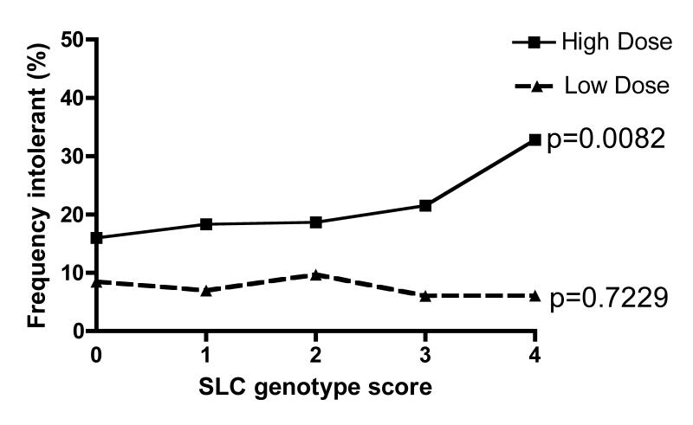
Frequentie van intolerantie in de gehele populatie gestratificeerd naar dosis
p-values shown are for Chi squared tests for trend (1df.) across the SLCO1B1 genotype score
Donnelly LA, et al. Clin Pharmacol Ther. 2011;89(2):210–6

Slide 77

Statines: bijwerkingen
Myopathie: elk type spierziekte^{1–3}
  Myalgie: pijn in een spier of spiergroep
    ~10%
  Myositis: spiersymptomen met ↑ CK
    ~2.5%
  Rhabdomyolyse: >50 maal ↑ in CK + nierinsufficiëntie
    <0.1%
Verhoogde AST en ALT⁴
  <3x ULN: ~1.3%
  >3x ULN: <1.0%
    Dosis-gerelateerd
OPMERKING: Raadpleeg de SmPC voor de volledige lijst van bijwerkingen die verband houden met statines. Alleen de 2 meest specifieke nadelige effecten van statines worden hier aangehaald
1. Bruckert E, et al. Cardiov Drugs. 2005;19:403;
2. Brown WV. Curr Opin Lipid. 2008;19:558; 3. Šimić I and Reiner Ž. Curr Pharm Des. 2015;21:1220–6; 4. Onusko E.
J Fam Pract. 2008;57:449
ALT, alanine aminotransferase; AST, aspartate aminotransferase; CK, creatine kinase; ULN, upper limit of normal

Slide 78
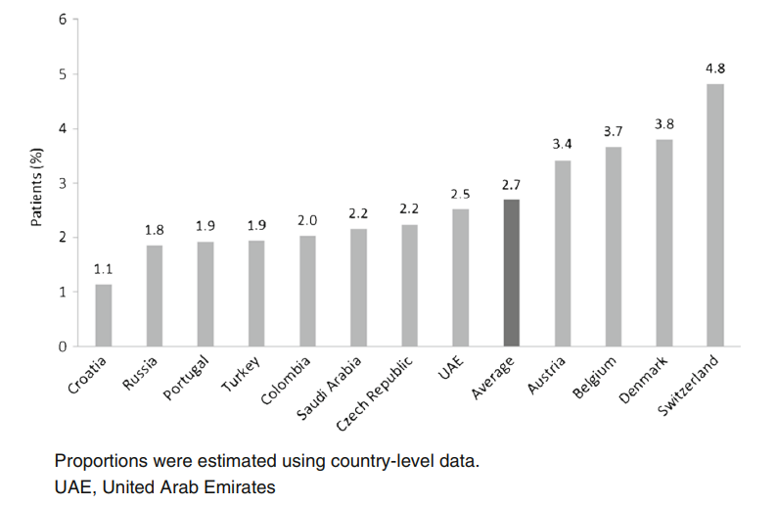
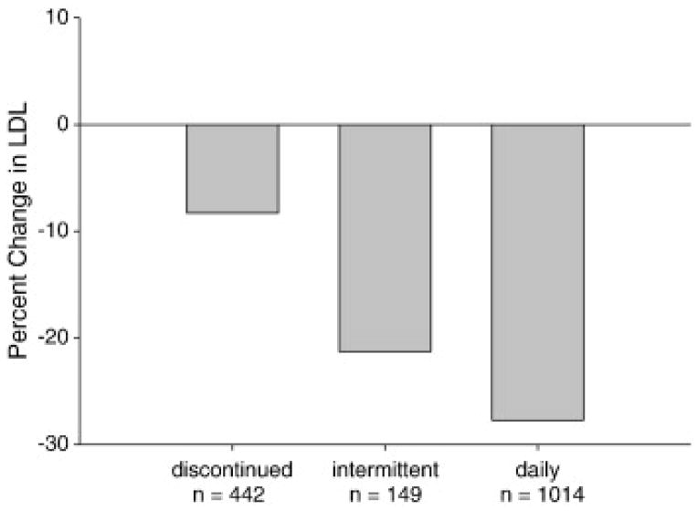
Statine-intolerantie en effectiviteit van intermitterende statinedosering bij LDL-C-reductie
Intermittent statin dosing may result in significant reduction in LDL-C¹
Estimated proportion of patients confirmed
to have statin intolerance²
LDL-C, low density lipoprotein cholesterol
1. Mampuya WM. Am Heart J. 2013;166(3):597–603;
2. Rosenson RS, et al. Cardiovasc Drugs Ther. 2017;31(2):187–95

Slide 79
Polling vraag
Wat zou uw behandelstrategie voor deze patiënt zijn?
A. Verlaag de dosis atorvastatine
B. Overschakelen van atorvastatine naar simvastatine 80 mg/dag
C. In plaats van atorvastatine, start met lage dosis rosuvastatine
D. Als de LDL-C streefwaarde niet wordt bereikt met een lage dosis rosuvastatine, dan voorschrift voor lage dosis rosuvastatine + ezetimibe
LDL-C, low density lipoprotein cholesterol

Slide 80
Polling vraag
Wat zou uw behandelstrategie voor deze patiënt zijn?
A. Verlaag de dosis atorvastatine
B. Overschakelen van atorvastatine naar simvastatine 80 mg/dag
C. In plaats van atorvastatine, start met lage dosis rosuvastatine
D. Als de LDL-C streefwaarde niet wordt bereikt met een lage dosis rosuvastatine, dan voorschrift voor lage dosis rosuvastatine + ezetimibe
LDL-C, low density lipoprotein cholesterol

Slide 81
Casus 3: Conclusies
Statine-intolerantie is het onvermogen om ten minste twee verschillende statines te verdragen - één statine bij de laagste dagelijkse startdosis en een tweede statine bij gelijk welke dosis¹
Een effectieve diagnose en onderscheid van statinegerelateerde bijwerkingen van andere aandoeningen is noodzakelijk om onnodige stopzetting van statines te voorkomen²
Mogelijke benaderingen: beginnend met een lage dosis van een andere statine - rechallenge, rosuvastatine met een zeer lage dosering (2,5 - 5 mg / dag), rosuvastatine 5 - 10 mg om de dag^{1,3}
Ezetimibe wordt aanbevolen als aanvullende behandeling bij een zeer lage of lage dosering rosuvastatine bij statine-intolerantie³
Bij patiënten met bevestigde statine-intolerantie of bij patiënten bij wie een statine gecontra-indiceerd is, moet ezetimibe worden overwogen⁴
1. Gulizia MM, et al. Eur Heart J Suppl. 2017;19 (Suppl. D):D55–D63; 2. Di Stasi SL, et al. Phys Ther. 2010;90(10):1530–42; 3. Jacobson TA, et al. J Clin Lipidol. 2014;8:473–88; 4. Mach F, et al. Eur Heart J. 2019;0:1–78

Slide 82
Casus 4

Slide 83
Casus 4: T2DM met recent NSTEMI
Patiënt gegevens
Demografie | 57 jaar, vrouw
Klinische/familiale geschiedenis | Patiënt had een NSTEMI 3 dagen geleden
CV risico factoren | Hypertensie, rookt 10 sigaretten per dag sedert 25 jaar; vader had een MI op 52-jarige leeftijd en een oudere broer, wie ook diabetes patiënt is, had een CABG op 49-jarige leeftijd
Onderzoeken | LDL-C = 95 mg/dL, HDL-C = 33 mg/dL, TG = 170 mg/dL, HbA_{1C} = 7.2%, creatinine = 106.08 mmol/L (1.2 mg/dL), eGFR = 50 mL/min/1.73m² (CKD-EPI)
Behandeling | Atorvastatine 10 mg sinds 5 jaar, olmesartan/amlodipine 20 mg/5 mg, metformin XR 1 g, empagliflozin 10 mg
Uitkomst | Werd onderworpen aan percutane coronaire interventie in de rechter kransslagader, 50% Laesie bij LAD, 70% linker circumflex, normale ventriculaire functie. Ontslagen met aspirine + clopidogrel en anti-hypertensive en anti-diabetische behandeling
Follow-up | Hoe lipiden onder controle houden?
Very high-risk individual
Residual mixed dyslipidaemia with low HDL-C despite use of low-dose statin
Persists smoking, CKD stage 3a
CABG, coronary artery bypass graft; CKD-EPI, Chronic Kidney Disease Epidemiology Collaboration; eGFR, epidermal growth factor receptor; HbA_{1c}, haemoglobin A1c; HDL-C, high-density lipoprotein cholesterol;
LDL-C, low-density lipoprotein cholesterol; LAD, left anterior descending; MI, myocard infarct; NSTEMI, non-ST segment elevation myocardial infarction; T2DM, type 2 diabetes mellitus; TG, triglyceride; XR, extended release

Slide 84
Risico van recurrente ASCVD: IMPROVE-IT
N=17,717 post-ACS
7-year follow-up
Diabetes + hypertension
+ smoking + CKD 3a = 4 points
ACS, acute coronary syndrome; ASCVD, atherosclerotic cardiovascular disease; CHF, chronic heart failure;
DM, diabetes mellitus; EZ, ezetimibe; HTN, hypertension; iCVA, ischaemic cerebrovascular accident; PAD, peripheral artery disease
Bohula EA, et al. JACC. 2017;69:911–21

Slide 85
Polling vraag
Wat zijn de aanbevolen LDL-C targets?
A. LDL-C <55 mg/dL (<1.4 mmol/L)
B. LDL-C <70 mg/dL (<1.8 mmol/L)
C. LDL-C <100 mg/dL (<2.6 mmol/L)
D. The lower the better
LDL-C, low density lipoprotein cholesterol

Slide 86
Polling vraag
Wat zijn de aanbevolen LDL-C targets?
A. LDL-C <55 mg/dL (<1.4 mmol/L)
B. LDL-C <70 mg/dL (<1.8 mmol/L)
C. LDL-C <100 mg/dL (<2.6 mmol/L)
D. The lower the better
LDL-C, low density lipoprotein cholesterol

Slide 87
ESC/EAS 2019 recommended LDL-C goals
Recommendations | Class* | Level†
In secondary prevention for patients at very-high risk, an LDL-C reduction of ≥50% from baseline and an LDL-C goal of <1.4 mmol/L (55 mg/dL) are recommended | I | A
In primary prevention for individuals at very-high risk, an LDL-C reduction of ≥50% from baseline and an LDL-C goal of <1.4 mmol/L (<55 mg/dL) are recommended | I | C
In patients at high risk, an LDL-C reduction of ≥50% from baseline and an LDL-C goal of <1.8 mmol/L (<70 mg/dL) are recommended | I | A
LDL-C, low density lipoprotein cholesterol
*Class of recommendation; †Level of evidence
Mach F, et al. Eur Heart J. 2019;0:1–78

Slide 88
Uncontrolled ASCVD risk factors in Europe:
30-year evolution in EUROASPIRE
Percentage of individuals with uncontrolled atherosclerotic cardiovascular disease risk factor at interview
30% only
EA, EUROASPIRE
Santos RD. Eur J Prevent Cardiol. 2019;26:820–3

Slide 89
Polling vraag
Hoe moet het daaruit voortvloeiende risico worden beheerd?
A. Rookstop + ezetimibe 10 mg
B. Rookstop + switch naar high intensity statin + ezetimibe
C. Rookstop + optitratie naar atorvastatine 80 mg
D. Rookstop + atorvastatine 40 mg + fenofibraat 160 mg

Slide 90
Polling vraag
Hoe moet het daaruit voortvloeiende risico worden beheerd??
A. Rookstopstop + ezetimibe 10 mg
B. Rookstop + switch naar high intensity statin + ezetimibe
C. Rookstop + optitratie naar atorvastatine 80 mg
D. Rookstop + atorvastatine 40 mg + fenofibraat 160 mg

Slide 91
T2DM with recent NSTEMI
Recommendations for the treatment of dyslipidaemia in diabetes | Class* | Level†
In patients with type 2 diabetes at very-high risk, an LDL-C reduction of ≥50% from baseline and an LDL-C goal of <1.4 mmol/L (<55 mg/dL) is recommended | I | A
In patients with type 2 diabetes at high risk, an LDL-C reduction of ≥50% from baseline and an LDL-C goal of <1.8 mmol/L (<70mg/mL) is recommended | I | A
Statins are recommended in patients with type 1 diabetes who are at high or very-high risk | I | A
Intensification of statin therapy should be considered before the introduction of combination therapy | IIa | C
If the goal is not reached, statin combination with ezetimibe should be considered | IIa | B
Statin therapy is not recommended in pre-menopausal patients with or without diabetes mellitus who are considering pregnancy, or not using adequate contraception | III | C
Statin therapy may be considered in both type 1 diabetes and type 2 diabetes patients aged ≥30 years with evidence of end organ damage and/or an LDL-C level >2.5 mmol/L, as long as pregnancy is not being planned | IIb | C
LDL-C, low density lipoprotein cholesterol; NSTEMI, non-ST segment elevation myocardial infarction; T2DM, type 2 diabetes mellitus
*Class of recommendation; †Level of evidence
Mach F, et al. Eur Heart J. 2019;0:1–78

Slide 92
Additionele LDL-C verlaging en reductie van ASCVD events in post-ACS diabetische patiënten volgens # risicofactoren: IMPROVE-IT
N = 4,933
Baseline:
LDL-C = 2.29 mmol/L
(89 mg/dL)
On treatment:
1.26 mmol/L
(49 mg/dL)
vs
1.72 mmol/L (67 mg/dL)
Giugliano RP, et al. Circulation. 2018;137:1571–82
ARR, absolute risk reduction; ASCVD, atherosclerotic cardiovascular disease HR, hazard ratio; ITT, intention-to-treat; LDL-C, low density lipoprotein cholesterol

Slide 93
Casus 5

Slide 94
Casus 5: Patiënt AW
Patiënt gegevens
Demografie | 50 jaar, man
Reden van de consultatie | Asymptomatisch, wil check-up alvorens fysiek trainingsprogramma te starten
Familiale geschiedenis | blanco
CV risico factoren | Roker 10 sigaretten/dag
Onderzoeken | BD = 140/86 mmHg, BMI = 25 kg/m², TC = 255 mg/dL, LDL-C = 180 mg/dL, HDL-C = 50 mg/dL, TG = 125 mg/dL, NON-HDL-C = 230 mg/dL, Lp(a) = 40 mg/dL, Glucose = 91 mg/dL
Very high-risk individual
Residual mixed dyslipidaemia with low HDL-C despite use of low-dose statin
Persists smoking, CKD stage 3a
Wat is zijn totaal cardiovasculair risico ?
Hoe interpreteert U zijn lipidenprofiel?
HDL-C, high-density lipoprotein cholesterol; LDL-C, low-density lipoprotein cholesterol; TG, triglyceride; BD, bloeddruk; BMI body mass index; TC, Lp(a), lipoprotein a

Slide 95
SCORE chart for European populations at low
cardiovascular disease risk
SCORE Cardiovascular Risk Chart
10-year risk of fatal CVD
Low-risk regions of Europe
Systolic blood pressure (mmHg)
WOMEN
MEN
Non-smoker
Smoker
Age
Non-smoker
Smoker
180 | 1 | 1 | 1 | 1 | 2 | 2 | 2 | 3
160 | 0 | 0 | 1 | 1 | 1 | 1 | 1 | 2
140 | 0 | 0 | 0 | 0 | 1 | 1 | 1 | 1
120 | 0 | 0 | 0 | 0 | 0 | 0 | 0 | 1
 | 4 | 5 | 6 | 7 | 4 | 5 | 6 | 7
2 | 2 | 3 | 3 | 4 | 5 | 5 | 6
1 | 1 | 2 | 2 | 2 | 3 | 3 | 4
1 | 1 | 1 | 1 | 1 | 2 | 2 | 3
0 | 1 | 1 | 1 | 1 | 1 | 1 | 2
4 | 5 | 6 | 7 | 4 | 5 | 6 | 7
50
Total cholesterol (mmol/L)
X 38,67 = mg/dL
 | <3% |  | 3-4% |  | 5-9% |  | ≥10%

Slide 96
Factoren die SCORE-risico kunnen wijzigen - Mr. AW
- Sociale klasse MIDDEN
- Obesitas en centrale obesitas NEEN - Fysieke inactiviteit NEEN
- Psychosociale stress Niet speciaal
- Familiale voorgeschiedenis van premature CVZ ( man < 55 jr; vrouw < 60 jr) NEEN
- Ernstige geestesziekten NEEN
- Chronische immuun-gemedieerde inflammatoire ziekten NEEN
- Behandeling voor HIV infectie NEEN
- Obstructieve slaap apnoe syndroom NEEN
- Andere lipiden parameters : Lp(a), HDL-C, TG, NEEN

Slide 97
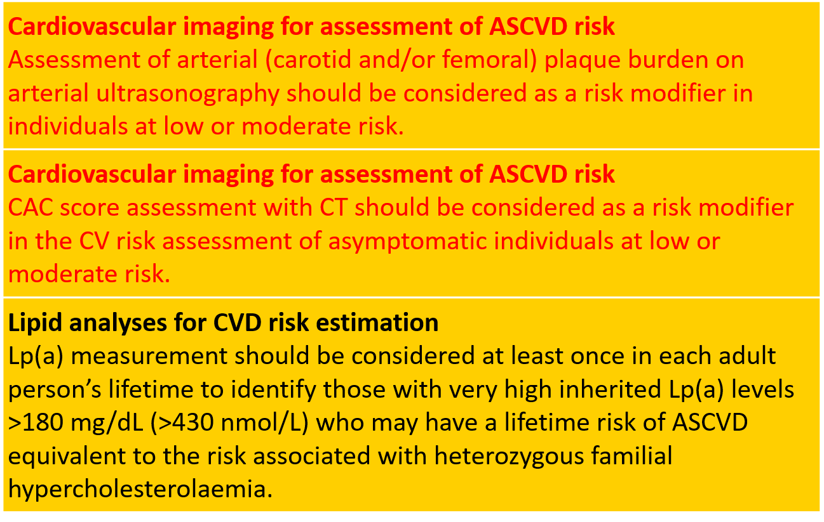
RISK ASSESSMENT - Imaging and Lp(a)

Slide 98
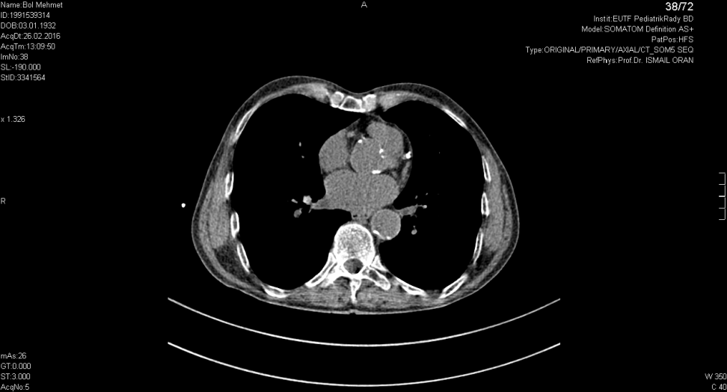
Casus 5 : Patiënt AW
Gelet op het ‘matig verhoogd’ totaal CV risico (3%/10 jr) werd een CT calcium score berekend.
Resultaten: AGATSTON score van 522 .

Slide 99
Cumulative Incidence of Coronary Events:
MESA Study

Slide 100
Casus 5 : Patiënt AW
- Asymptomatisch, komt voor een check-up;
wil trainingsprogramma volgen.
- Zijn inspanningsvermogen wordt getest op een cycloergometer.
Mr AW ontwikkelt pijn op de borst bij maximale inspanning met een significante ST depressie in de precordiale EKG afleidingen.
Een coronaire angiografie wordt aanbevolen

Slide 101
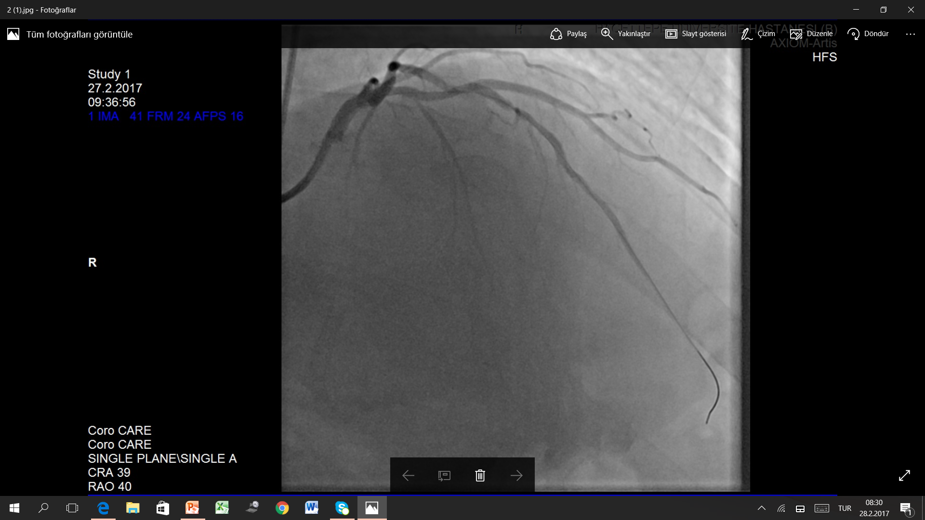
Casus 5 : Coronaire angiografie

Slide 102
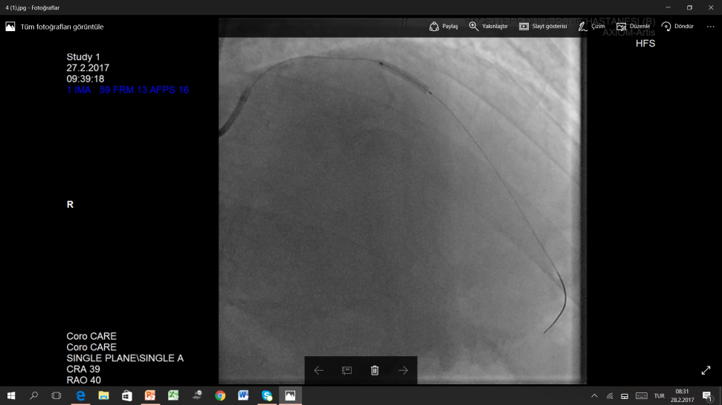

Casus 5 : Succesvolle stenting van de LAD
LAD, left anterior descending

Slide 103
Casus 5 : Patiënt AW
Ontslag met dual antiplatelet therapy en een statine.
Een cardiaal revalidatieprogramma wordt aanbevolen,
met bijzondere aandacht voor rookstop.
Wat is zijn streefwaarde voor LDL-C ?

Slide 104
Casus 5 : Patiënt AW - streefwaarde voor LDL-C
Prematuur coronair lijden + verhoogde Agatston score
= sterk-verhoogd risico
Guideline: Sterk-verhoogd totaal CV risico:
- een LDL-C reductie van minstens 50% van het onbehandeld gehalte en
- een LDL-C streefwaarde van < 55 mg/dL
Mr. AW: onbehandeld LDL-C: 180 mg/dL
streefwaarde: < 55 mg/dL en minstens -50% = -125 mg/dL of – 69% reductie
→Start met een hoge dosis van een hoge-intensiteit statine in combinatie met ezetimibe - dit geeft gemiddeld tot 70% reductie.

Slide 105
Casus 6

Slide 106
Casus 6: Patiënt met FH
Patiënt gegevens
Demografie | 52 jaar, vrouw
Klinische/familiale geschiedenis | vader: overleden op de leeftijd van 50 jaar Broer: MI op leeftijd van 42 jaar, hoge cholesterol Asymptomatische, hoge cholesterol gekend sinds 3 jaar Initiële lipid profiel: LDL-C= 317 mg/dL BMI= 24 kg/m², BD= 123/78 mmHg, verdikte Achillespees
Behandeling | Atorvastatine 40 mg sinds 3 jaar
Onderzoeken | LDL-C = 185 mg/dL HDL-C = 52 mg/dL TG = 75 mg/dL
Follow-up | ?
BMI, body mass index; BD, bloeddruk; FH, familial hypercholesterolaemia; HDL-C, high-density lipoprotein cholesterol;
LDL-C, low-density lipoprotein cholesterol; MI, myocardial infarction; TG, triglyceride

Slide 107
Polling vraag
Hoe zou uw behandelingsstrategie eruit zien?
High intensity statine + ezetimibe combinatie
Stel een genetische test voor FH voor
Meet Lp(a)
Evalueer sub-klinische atherosclerose
Al de bovenstaande
FH, familial hypercholesterolaemia; Lp(a), lipoprotein(a)

Slide 108
Polling vraag
Hoe zou uw behandelingsstrategie eruit zien?
High intensity statine + ezetimibe combinatie
Stel een genetische test voor FH voor
Meet Lp(a)
Evalueer sub-klinische atherosclerose
Al de bovenstaande
FH, familial hypercholesterolaemia; Lp(a), lipoprotein(a)

Slide 109
Verkalking van de kransslagader en CV events bij met statines behandelde FH
206 molecularly proven HeFH individuals
Age 45±14 years
79.6% with high-dose statin
64% also with ezetimibe
On-treatment LDL-C 150±56 mg/dL
p=0.0003
CAC present in 105 individuals (51%)
Follow-up median of 3.7 (quartiles: 2.7–6.8) years
ASCVD events (7.2%)
Annualised event rate (1,000 patients/year)
CAC 0 = 0
CAC 1–100 = 26.4 (95% CI 12.9–51.8)
>100 = 44.1 (95% CI 26.0–104.1)
ASCVD, atherosclerotic cardiovascular disease; CAC, coronary artery calcium score; CI, confidence interval; HeFH, heterozygous familial hypercholesterolaemia; MACE, major adverse cardiac event
Miname MH, et al. JACC Cardiovasc Imaging. 2018 [Epub ahead of print]

Slide 110
Casus 6: Patiënt met FH
Patient details
Demografie | 52 jaar, vrouwelijke patient
Klinische/familiale geschiedenis | vader: overleden op de leeftijd van 50 jaar Broer: MI op leeftijd van 42 jaar, hoge cholesterol Asymptomatische, hoge cholesterol gekend sinds 3 jaar Initiële lipiden profiel: LDL-C = 317 mg/dL BMI= 24 kg/m², BD= 123/78 mmHg, verdikte Achillespees
CAC score | 2,300 Agatston units  Coronarographie  CABG
Genetische analyse | Heterozygoot FH geconfirmeerd door genetische analyse (duplicatie van exons 13 en 14 in LDL receptor gen)
Behandeling | Rosuvastatine 20 mg + ezetimibe 10 mg
Lipiden profiel | LDL-C = 135 mg/dL Lp(a) = 124 mg/dL
BMI, body mass index; BD, bloeddruk; CABG, coronary artery bypass graft; FH, familial hypercholesterolaemia; LDL-C, low density lipoprotein cholesterol; Lp(a), lipoprotein (a); MI, myocardial infarction

Slide 111
Polling vraag
Wat zou uw aanpak zijn?
Switch naar atorvastatine 80 mg + ezetimibe 10 mg
Optitratie rosuvastatine naar 40 mg
Voeg PCSK9 inhibitor toe
LDL-apherese
PCSK9, proprotein convertase subtilisin/kexin type 9

Slide 112
Polling vraag
Wat zou uw aanpak zijn?
Switch naar atorvastatine 80 mg + ezetimibe 10 mg
Optitratie rosuvastatin naar 40 mg
Voeg PCSK9 inhibitor toe
LDL-apherese
PCSK9, proprotein convertase subtilisin/kexin type 9

Slide 113
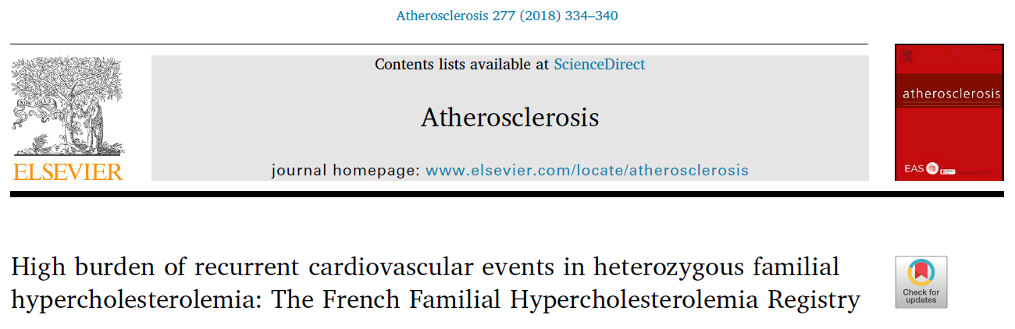
Patiënt met FH
Key findings
First CV event occurred at the mean age of 47 years (72% male)
37% of patients had at least one recurrent CV event (mean of 1.8 events per patient)
CV, cardiovascular
Béliard S, et al. Atherosclerosis. 2018;277:334–40

Slide 114
Patiënt met FH
Recommendations | Class* | Level†
It is recommended that a diagnosis of FH is considered in patients with CHD aged <55 years for men and <60 years for women, in people with relatives with premature fatal or non-fatal CVD, in people with relatives having tendon xanthomas, in people with severely elevated LDL-C levels [in adults >5 mmol/L (<190 mg/dL)], in children >4 mmol/L (>150 mg/dL)], and in first-degree relatives of FH patients | I | C
It is recommended that FH is diagnosed using clinical criteria and confirmed, when possible, with DNA analysis | I | C
Once the index case is diagnosed, family cascade screening is recommended | I | C
It is recommended that FH patients with ASCVD or who have another major risk factor are treated as very-high-risk, and those with no prior ASCVD or other risk factors as high-risk | I | C
For FH patients with ASCVD who are at very-high risk, treatment to achieve a ≥50% reduction from baseline and an LDL-C <1.4 mmol/L (<55 mg/dL) is recommended. If goals cannot be achieved, a drug combination is recommended | I | C
Treatment with a PCSK9 inhibitor is recommended in very-high risk FH patients if the treatment goal is not achieved on a maximal tolerated statin plus ezetimibe | I | C
In children, testing for FH is recommended from the age of 5 years, or earlier if HoFH is suspected | I | C
ASCVD, atherosclerotic cardiovascular disease; CHD, coronary heart disease; HoFH, homozygous familial hypercholesterolaemia; LDL-C, low density lipoprotein cholesterol; PCSK9, proprotein convertase subtilisin/kexin type 9; *Class of recommendation; †Level of evidence
Mach F, et al. Eur Heart J. 2019;0:1–78

Slide 115
Dutch Lipid Clinic Network diagnostic criteria for
familial hypercholesterolaemia (1)
Criteria | Points
1) Family history
First-degree relative with known premature (men <55 years; women <60 years) coronary or vascular disease, or first-degree relative with known LDL-C above the 95th percentile | 1
First-degree relative with tendinous xanthomata and/or arcus cornealis, or children <18 years of age with LDL-C above the 95th percentile | 2
2) Clinical history
Patient with premature (men <55 years; women <60 years) coronary artery disease | 2
Patient with premature (men <55 years; women <60 years) cerebral or peripheral vascular disease | 1

Slide 116
Dutch Lipid Clinic Network diagnostic criteria for
familial hypercholesterolaemia (2)
Criteria | Points
3) Physical examinationª
Tendinous xanthomata | 6
Arcus cornealis before age 45 years | 4
4) LDL-C levels (without treatment)
LDL-C ≥8.5 mmol/L (≥325 mg/dL) | 8
LDL-C 6.5–8.4 mmol/L (251–325 mg/dL) | 5
LDL-C 5.0–6.4 mmol/L (191–250 mg/dL) | 3
LDL-C 4.0–4.9 mmol/L (155–190 mg/dL) | 1
ª Exclusive of each other (i.e. maximum 6 points if both are present).

Slide 117
Dutch Lipid Clinic Network diagnostic criteria for
familial hypercholesterolaemia (3)
Criteria | Points
5) DNA analysis
Functional mutation in the LDLR, ApoB or PCSK9 genes | 8
Choose only one score per group, the highest applicable (diagnosis is based on the total number of points obtained)
A ‘definite’ FH diagnosis requires >8 points pt FH 22 punten
A ‘probable’ FH diagnosis requires 6–8 points
A ‘possible’ FH diagnosis requires 3–5 points

Slide 118
Patiënt met FH
Aanbevelingen
De behandeling moet worden gestart met een zeer intensieve statinetherapie, meestal in combinatie met ezetimibe¹
Voor FH-patiënten met een zeer hoog risico (dat wil zeggen met ASCVD of met een andere belangrijke risicofactor) die hun doel op een maximaal getolereerde dosis van een statine en ezetimibe niet bereiken, wordt een combinatie met een PCSK9-remmer aanbevolen¹
Alle eerste-graad familieleden worden aanbevolen hun risicoprofiel te laten bepalen in het bijzonder het lipidenprofiel (cascade screening)
1. Mach F, et al. Eur Heart J. 2019;0:1–78
ASCVD, atherosclerotic cardiovascular disease; FH, familial hypercholesterolaemia; PCSK9, proprotein convertase subtilisin/kexin type 9

Slide 119
Samenvatting

Slide 120
Samenvatting en take-home message
Richtlijnen Dyslipidemie ESC/EAS 2019
De 2019 ESC/EAS dyslipidemie richtlijnen hebben nieuwe doelen gesteld voor LDL-C verlaging volgens het CV risico en bevelen combinatie therapie aan in veel gevallen om doelwaarde én ≥50% reductive te bereiken
Case studies
Beoordeling van het 10-jaars risico op fatale HVZ wordt geïllustreerd op basis van de nieuwe SCORE cardiovasculaire risicokaarten.
Statine-intolerantie is niet zeldzaam en als de LDL-C-streefwaarde niet wordt bereikt met een lage dosis statine, wordt ezetimibe aanbevolen als aanvullende behandeling
Bij patiënten met type 2 diabetes met een zeer hoog risico wordt een LDL-C-reductie van ≥50% ten opzichte van de uitgangswaarde en een LDL-C-doel van <55 mg / dL aanbevolen.
Voor FH-patiënten met een zeer hoog risico (dat wil zeggen met ASCVD of met een andere belangrijke risicofactor) die hun doel met een maximaal getolereerde dosis van een statine en ezetimibe niet bereiken, wordt een combinatie met een PCSK9-remmer aanbevolen
Key take-home
De nieuwe richtlijnen zullen meer patiënten toelaten om het LDL-C-doel te bereiken, door het juiste en tijdige gebruik van combinatietherapiebenaderingen
ASCVD, atherosclerotic cardiovascular disease; CV, cardiovascular; FH, familial hypercholesterolaemia; LDL-C, low density lipoprotein cholesterol; PCSK9, proprotein convertase subtilisin/kexin type 9

