Slide 1
Individualizing r-ATG Exposure: Key to
Overcome Drawbacks of Current Weight-based r-ATG Dosing
MAT-IN-2300736-v1.0/03/2023
r-ATG: Rabbit anti-thymocyte globulin.
Notes:
Hello everyone. Welcome to the session on individualizing rabbit anti-thymocyte globulin (r-ATG) exposure—the key to overcoming the drawbacks of current weight-based r-ATG dosing.

Slide 2
Table of Contents
01
03
05
07
Association between r-ATG exposure and the 5-year overall survival outcome
Retrospective Review of Use of Individualized Dosing of
r-ATG
Optimal Active
r-ATG Exposure Associated with Minimum Risk of Virus Reactivation
Current r-ATG dosing strategy and guidelines
02
04
06
08
Association between r-ATG exposure and CD4⁺ immune reconstitution
PARACHUTE Study
Individualization of r-ATG Dosing and the Way Forward
Body weight and ALC-based r-ATG Nomogram Dosing in Patients with Inborn Errors of Metabolism
CD4⁺: Cluster of differentiation 4⁺; r-ATG: Rabbit anti-thymocyte globulin.
Notes:
In this session, we will discuss the following topics:
Current rabbit anti-thymocyte globulin (r-ATG) dosing strategy and guidelines
Association between r-ATG exposure and cluster of differentiation 4⁺ immune reconstitution
Association between r-ATG exposure and the 5-year overall survival outcome
PARACHUTE study
Retrospective review of the use of individualized dosing of r-ATG
Body weight and absolute lymphocyte count-based r-ATG nomogram dosing in patients with inborn errors of metabolism
Optimal active r-ATG exposure associated with minimum risk of virus reactivation
Individualization of r-ATG dosing and the way forward

Slide 3

r-ATG, a potent
T-lymphocyte depleting agent, is now an integral part of many aHSCT protocols due to its role in preventing GvHD, a deadly complication of aHSCT
Prevention
GvHD
Admiraal R, et al. Lancet Haematol. 2017;4(4):e183–e191.
aHSCT: Allogenic hematopoietic stem cell transplantation; GvHD: Graft versus host disease; r-ATG: Rabbit anti-thymocyte globulin.
Notes:
Allogeneic hematopoietic cell transplantation (aHSCT) is a potential therapeutic treatment option for high-risk or relapsed acute leukemias and myelodysplastic syndrome. One of the severe complications of aHSCT leading to mortality and morbidity is graft vs. host disease. Therefore, as a strategy to prevent this complication, rabbit anti-thymocyte globulin has been added as a part of the conditioning regimen, thus, forming an integral part of many aHSCT protocols.
Reference
Admiraal R, Nierkens S, de Witte MA, et al. Association between anti-thymocyte globulin exposure and survival outcomes in adult unrelated haemopoietic cell transplantation: A multicentre, retrospective, pharmacodynamic cohort analysis. Lancet Haematol. 2017;4(4):e183–e191.

Slide 4



Current r-ATG Dosing Strategy
Did you know, the current weight-based r-ATG dosing is empiric at its best and has significant limitations?¹
Challenges related to the strategy^{1–5}
Poor T cell reconstitution
Reduced graft versus leukemia effect
Increased relapse and non-relapse mortality
1. Admiraal R, et al. Lancet Haematol. 2017;4(4):e183–e191; 2. Lindemans CA, et al. Blood. 2014;123:126–132. 3. Kröger N, et al. N Engl J Med. 2016;374:43–53. 4. Bartelink IH, et al. Biol Blood Marrow Transplant. 2013;19:305–313. 5. Bosch M, et al. Cytotherapy. 2012;14:1258–1275.
r-ATG: Rabbit anti-thymocyte globulin.
Notes:
In this section, we will discuss the current strategy of rabbit anti-thymocyte globulin (r-ATG) dosing and its implications in the treatment of allogeneic hematopoietic stem cell transplantation patients (aHSCT).¹
Although r-ATG has been added as a part of aHSCT conditioning regimen for graft vs. host disease (GvHD) prevention, its advantages in improving patient survival rate are not appreciable.¹
One of the reasons, attributed to this disadvantage could be the method of dosing strategy, where the in vivo T-cell depletion of the graft has proven to be unpredictable and can result in delayed or absent T-cell reconstitution.¹
Did you know, the current weight-based r-ATG dosing is empiric at its best, but it has significant limitations? The current dosing strategy uses standard dosing for all patients without taking exposure into account. So, that being said, let us understand what are the challenges related to the strategy. The challenges are:^{1–5}
Poor T-cell reconstitution
Reduced graft vs. leukemia effect
Increased relapse and non-relapse mortality
References
Admiraal R, Nierkens S, de Witte MA, et al. Association between anti-thymocyte globulin exposure and survival outcomes in adult unrelated haemopoietic cell transplantation: A multicentre, retrospective, pharmacodynamic cohort analysis. Lancet Haematol. 2017;4(4):e183–e191.
Lindemans CA, Chiesa R, Amrolia PJ, et al. Impact of thymoglobulin prior to pediatric unrelated umbilical cord blood transplantation on immune reconstitution and clinical outcome. Blood. 2014;123:126–132.
Kröger N, Solano C, Wolschke C, et al. Antilymphocyte globulin for prevention of chronic graft-versus-host disease. N Engl J Med. 2016;374:43–53.
Bartelink IH, Belitser SV, Knibbe CAJ, et al. Immune reconstitution kinetics as an early predictor for mortality using various hematopoietic stem cell sources in children. Biol Blood Marrow Transplant. 2013;19:305–313.
Bosch M, Dhadda M, Hoegh-Petersen M, et al. Immune reconstitution after anti-thymocyte globulin-conditioned hematopoietic cell transplantation. Cytotherapy. 2012;14:1258–1275.

Slide 5

Significance of r-ATG Dosing
Timely T cell
reconstitution
Preventing
GvHD
Dose of r-ATG is pivotal in maintaining a balance
Admiraal R, et al. Lancet Haematol. 2017;4(4):e183–e191.
GvHD: graft versus host disease; r-ATG: Rabbit anti-thymocyte globulin.
Notes:
Now, let us understand the significance of rabbit anti-thymocyte globulin (r-ATG) dosing. The patients of allogeneic hematopoietic stem cell transplantation are exposed to r-ATG before and after transplantation, and the reconstitution of T-cell was found to be dependent on the half-life of the r-ATG. Several studies have shown that the dosage of r-ATG is very important in maintaining a delicate balance between timely T-cell reconstitution and preventing graft vs. host disease.
Reference
Admiraal R, Nierkens S, de Witte MA, et al. Association between anti-thymocyte globulin exposure and survival outcomes in adult unrelated haemopoietic cell transplantation: A multicentre, retrospective, pharmacodynamic cohort analysis. Lancet Haematol. 2017;4(4):e183–e191.

Slide 6


Population Pharmacokinetics model—Key to Optimal Patient Outcomes^{1,2}
recommends
Population pharmacokinetics modeling to determine an optimum individual r-ATG exposure³
1. US Food and Drug Administration. Guidance for industry–population pharmacokinetics. 1999. Available at: http://www.fda.gov/downloads/drugs/guidances/UCM072137.pdf. Accessed on: 8 March 2023. 2. European Medicines Agency. Guideline on reporting the results of population pharmacokinetic analyses. 2007. Available at: http://www.ema.europa.eu/docs/en_GB/document_library/Scientific_guideline/2009/09/WC500003067.pdf. Accessed on: 8 March 2023. 3. Admiraal R, et al. Lancet Haematol. 2017;4(4):e183–e191.
EMA: European medicines agency; FDA: United States food and drug administration; r-ATG: Rabbit anti-thymocyte globulin.
Notes:
So, what will help us calculate an optimal dose of rabbit anti-thymocyte globulin (r-ATG) for best patient outcomes?
Population pharmacokinetic modeling can be used to describe pharmacokinetics and determine individual exposure and is the standard for reporting pharmacokinetic data according to current United States Food and Drug Administration and European Medicines Agency guidelines. Therefore, population pharmacokinetics modeling is the recommended strategy to determine an optimum r-ATG exposure for the best patient outcomes.^{1–3}
References
US Food and Drug Administration. Guidance for industry–population pharmacokinetics. 1999. Available at: http://www.fda.gov/downloads/drugs/guidances/UCM072137.pdf. Accessed on: 8 March 2023.
European Medicines Agency. Guideline on reporting the results of population pharmacokinetic analyses. 2007. Available at: http://www.ema.europa.eu/docs/en_GB/document_library/Scientific_guideline/2009/09/WC500003067.pdf. Accessed on: 8 March 2023.
Admiraal R, Nierkens S, de Witte MA, et al. Association between anti-thymocyte globulin exposure and survival outcomes in adult unrelated haemopoietic cell transplantation: A multicentre, retrospective, pharmacodynamic cohort analysis. Lancet Haematol. 2017;4(4):e183–e191.

Slide 7


Pharmacokinetic modeling studies and clinical trials demonstrate a strong relationship between the r-ATG exposure and T-cell reconstitution
r-ATG Exposure
T-cell reconstitution
Admiraal R, et al. Lancet Haematol. 2015;2(5):e194–e203.
r-ATG: Rabbit anti-thymocyte globulin.
Notes:
A multicenter, retrospective pharmacodynamic cohort analysis conducted by Rick Admiraal et al. demonstrates a strong relationship between the exposure of rabbit anti-thymocyte globulin and T-cell reconstitution. Let us learn more about the study and its outcomes in the next slide.
Reference
Admiraal R, van Kesteren C, Jol-van der Zijde CM, et al. Association between anti-thymocyte globulin exposure and CD4⁺ immune reconstitution in paediatric haemopoietic cell transplantation: A multicentre, retrospective pharmacodynamic cohort analysis. Lancet Haematol. 2015;2(5):e194–e203.

Slide 8
Association between r-ATG exposure and CD4⁺ immune reconstitution (1/2)
Study Design
Retrospective analysis of aHSCT patients; n=251
Main Outcome
Immune reconstitution—repopulation of T-cells
Study Population
Pediatric patients of aHSCT; Age:0.2–23 years
Successful Primary Endpoint
CD4⁺ T-cells count
≥0.05×10⁹ cells twice within 100 days after aHSCT
Study Duration
1st April 2004 to 1st April 2012
Admiraal R, et al. Lancet Haematol. 2015;2(5):e194–e203.
aHSCT: Allogenic hematopoietic stem cell transplantation; CD4⁺: Cluster of differentiation 4⁺; r-ATG: Rabbit anti-thymocyte globulin.
Notes:
To understand the association between anti-thymocyte globulin exposure and cluster of differentiation 4⁺ (CD4⁺) immune reconstitution, a multicenter retrospective study was conducted on pediatric patients of allogeneic hematopoietic stem cell transplantation (aHSCT) between 1 April 2004 and 1 April 2012 in the Netherlands. About 251 patients of age 0.2 to 23 years receiving their first aHSCT were enrolled in the study. The main outcome of the study was the successful immune reconstitution of CD4⁺ T-cells count ≥0.05×10⁹ cells twice within 100 days after aHSCT. This was set as the primary endpoint and the other outcomes of interest are overall survival, acute and chronic graft vs. host disease, and graft failure.
Reference
Admiraal R, van Kesteren C, Jol-van der Zijde CM, et al. Association between anti-thymocyte globulin exposure and CD4+ immune reconstitution in paediatric haemopoietic cell transplantation: A multicentre, retrospective pharmacodynamic cohort analysis. Lancet Haematol. 2015;2(5):e194–e203.

Slide 9
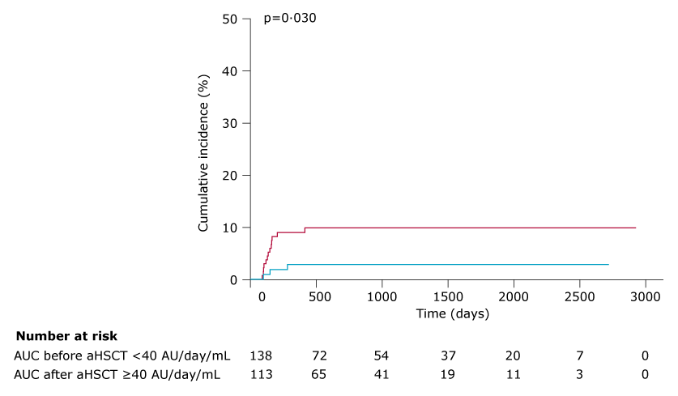
Association between r-ATG exposure and CD4⁺ immune reconstitution (2/2)
Findings
Increase in r-ATG exposure after aHSCT—decreases the chance of successful immune reconstitution with odds ratio 0.991, 95% CI 0.987–0.996; p<0.0001.
r-ATG AUC threshold minimum of 40 AU/day/mL significantly reduced aGvHD and cGvHD
Conclusion
Individualized dosing and timing of r-ATG to aim for optimum exposure before and after aHSCT could result in improved outcomes after aHSCT.
Cumulative incidence curves for graft failure according to AUC before transplantation
Admiraal R, et al. Lancet Haematol. 2015;2(5):e194–e203.
aHSCT: Allogenic hematopoietic stem cell transplantation; AU: Arbitrary units; AUC: Area under the curve; CD4⁺: Cluster of differentiation 4⁺; CI: Confidence interval; r-ATG: Rabbit anti-thymocyte globulin.
Notes:
Here we will see the outcomes of the study:
The following observations were made depending on the outcome of the study:
Increase in rabbit anti-thymocyte globulin (r-ATG) exposure after allogeneic hematopoietic stem cell transplantation (aHSCT)—decreases the chance of successful immune reconstitution with odds ratio 0.991, 95% confidence interval 0.987–0.996; p<0.0001.
The minimum threshold of the area under the curve of r-ATG should be 40 arbitrary units per day per milliliter to significantly reduce the acute and chronic graft vs. host disease.
The findings point us to the fact that the individualized dosing and timing of r-ATG are the important factors in determining an optimum exposure before aHSCT and for optimum outcomes after aHSCT.
Reference
Admiraal R, van Kesteren C, Jol-van der Zijde CM, et al. Association between anti-thymocyte globulin exposure and CD4+ immune reconstitution in paediatric haemopoietic cell transplantation: A multicentre, retrospective pharmacodynamic cohort analysis. Lancet Haematol. 2015;2(5):e194–e203.

Slide 10


Association between r-ATG exposure and the 5-year overall survival outcome (1/2)
Study Design
Retrospective, pharmacokinetic-pharmacodynamic analysis of data; n=146
Study Population and Duration
Data of patients with acute lymphoid leukemia, acute myeloid leukemia, or myelodysplastic syndrome was studied from 1st March 2004 to
1st June 2015
Main Outcome
5-year overall survival
Admiraal R, et al. Lancet Haematol. 2017;4(4):e183–e191.
r-ATG: Rabbit anti-thymocyte globulin.
Notes:
Next, let us understand the association between rabbit anti-thymocyte globulin (r-ATG) exposure and the 5-year survival outcome of allogeneic hematopoietic stem cell patients (aHSCT). A retrospective pharmacokinetic–pharmacodynamic analysis was performed on the data of patients with acute lymphoid leukemia, acute myeloid leukemia, or myelodysplastic syndrome undergoing T-cell replete allogeneic peripheral blood stem cell HCT with r-ATG as part of non-myeloablative conditioning from March 1, 2004, to June 1, 2015, in the Netherlands.
The minimal follow-up of the patients was 6 months. The main outcome of interest was 5-year overall survival, defined as the days to death from any cause or last follow-up.
The other outcomes of the study were non-relapse mortality and relapse mortality. The duration of the follow-up was the time from aHSCT to last contact or death and the factors considered as the predictors of outcome were:
Age
Sex
Epstein–Barr virus and cytomegalovirus serostatus
European Society for Bone Marrow Transplantation (EBMT)
Reference
Admiraal R, Nierkens S, de Witte MA, et al. Association between anti-thymocyte globulin exposure and survival outcomes in adult unrelated haemopoietic cell transplantation: A multicentre, retrospective, pharmacodynamic cohort analysis. Lancet Haematol. 2017;4(4):e183–e191.

Slide 11
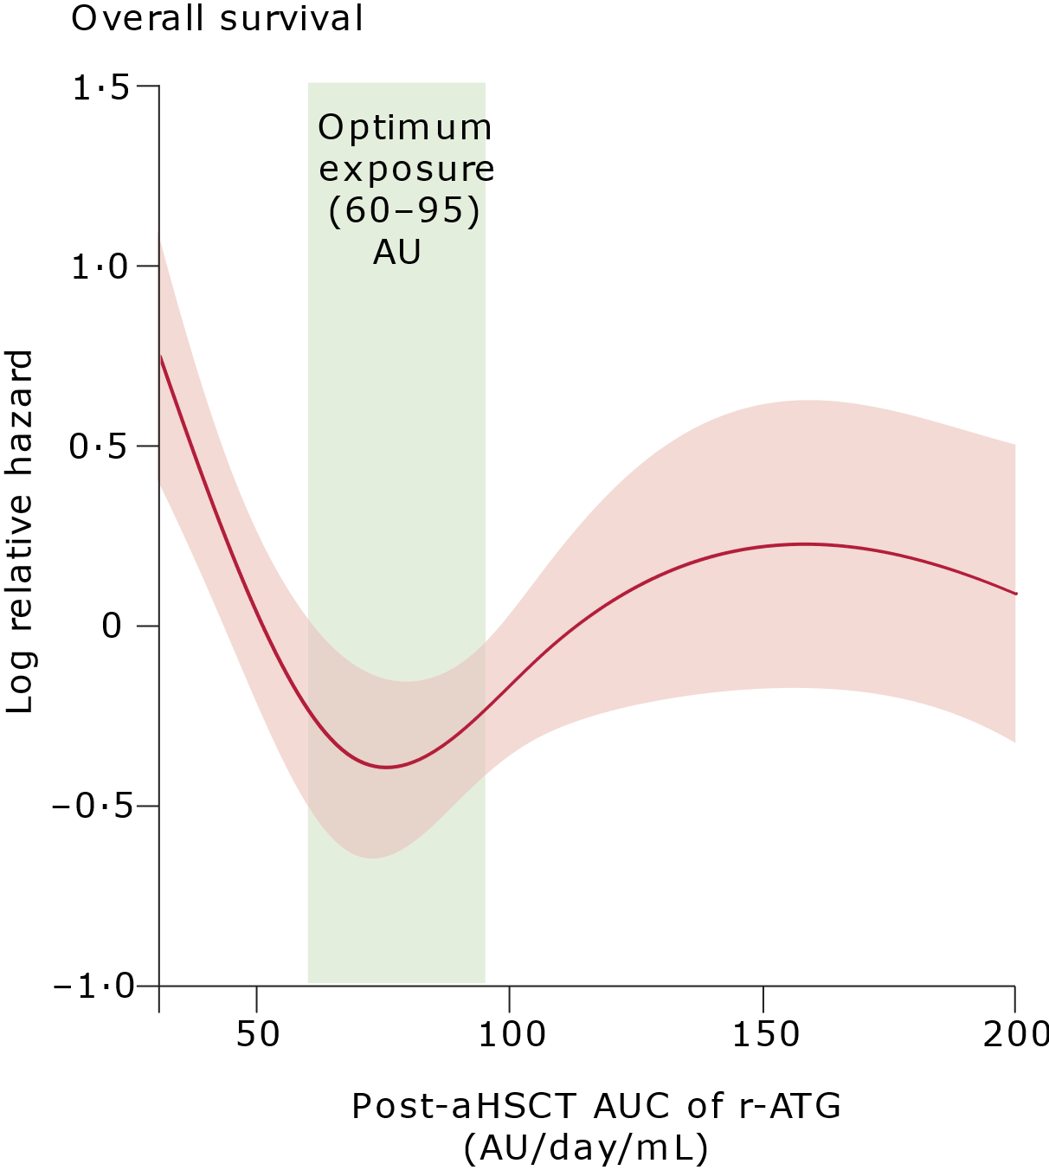

Association between r-ATG exposure and the 5-year overall survival outcome (2/2)
Findings
Optimum r-ATG exposure post-aHSCT = 60–95 AU/day/mL
r-ATG exposure after aHSCT—Best predictor of 5-year survival
ALC modeled dosing is better than weight-based dosing for optimal target exposure of r-ATG in patients >50kg
Conclusion
Exposure to ATG affects survival after aHSCT in adults, stressing the importance of optimum ATG dosing.
Individualized dosing of ATG, based on lymphocyte counts rather than bodyweight, might improve survival chances after aHSCT
Optimum r-ATG exposure after aHSCT for favorable overall survival
Cumulative Intravenous r-ATG dosage
=400+350×lymphocyte count (in 10⁹/L)
Admiraal R, et al. Lancet Haematol. 2017;4(4):e183–e191.
aHSCT: Allogenic hematopoietic stem cell transplantation; ALC: Absolute lymphocyte count; AU: Arbitrary units; AUC: Area under the curve; r-ATG: Rabbit anti-thymocyte globulin.
Notes:
So, what were the outcomes of the analysis?
The findings prove that rabbit anti-thymocyte globulin (r-ATG) exposure after allogeneic hematopoietic stem cell transplantation (aHSCT) is the best predictor of 5-year survival and an optimum level of r-ATG in patients over 50 kg can be calculated using absolute lymphocyte count-based dosing strategy.
Optimum r-ATG exposure after aHSCT is equal to 60 to 95 arbitrary units per day per millilitre.
Also, they devised a formula to calculate the amount of intravenous r-ATG dosage, which is 400+350 (lymphocyte count) in 10⁹ per litre.
It was concluded that optimum r-ATG dosing taking exposure into account affects the survival outcomes after aHSCT.
Individualized dosing of ATG, based on lymphocyte counts rather than body weight, might improve survival chances after aHSCT.
Reference
Admiraal R, Nierkens S, de Witte MA, et al. Association between anti-thymocyte globulin exposure and survival outcomes in adult unrelated haemopoietic cell transplantation: A multicentre, retrospective, pharmacodynamic cohort analysis. Lancet Haematol. 2017;4(4):e183–e191.

Slide 12
PARACHUTE Study (1/2)
Prospective clinical evidences on individualization of r-ATG dose and aHSCT outcomes
Study Design
Intervention
Primary Endpoint
Prospective, open-label, non-randomized,
single-arm, phase 2 clinical trial.
Treated with individualized dosing regimen based on body-weight and ALC at the time of r-ATG initiation
T-cell reconstitution >0.05×10⁹ CD4⁺ T cells/L twice within 100 days [±3] post-aHSCT
Population
aHSCT pediatric patients
(<18 years)
Duration
1st July 2015 to 22nd August 2018; n=58
Admiraal R, et al. Lancet Haematol. 2022;9(2):e111–e120.
aHSCT: Allogenic hematopoietic stem cell transplantation; ALC: Absolute lymphocyte count; CD4⁺: Cluster of differentiation 4⁺; r-ATG: Rabbit anti-thymocyte globulin.
Notes:
One of the pioneer studies on the dosing strategy of rabbit anti-thymocyte globulin (r-ATG) was the parachute study held at the University Medical Centre Utrecht and the Princess Máxima Centre for Pediatric Oncology (Utrecht, the Netherlands) to investigate individualized dosing of anti-thymocyte globulin for unrelated allogeneic hematopoietic stem cell transplantation (aHSCT) in pediatric patients.
This was a prospective, open-label, non-randomized, single-arm, phase 2 clinical trial conducted on 58 patients held between July 1, 2015 and Aug 22, 2018. The patients were treated with an individualized dosing regimen based on body weight and absolute lymphocyte count at the time of r-ATG initiation. The primary endpoint set to a successful T-cell reconstitution of >0.05×10⁹ cluster of differentiation 4⁺ T cells/L twice within 100 days [±3] after aHSCT.
Reference
Admiraal R, Nierkens S, Bierings MB, et al. Individualised dosing of anti-thymocyte globulin in paediatric unrelated allogeneic haematopoietic stem-cell transplantation (PARACHUTE): A single-arm, phase 2 clinical trial. Lancet Haematol. 2022;9(2):e111–e120.

Slide 13

PARACHUTE Study (2/2)
Prospective clinical evidences on individualization of r-ATG dose and aHSCT outcomes
ALC-based dosing regimen led to optimum r-ATG exposure in
97% vs. 30%–53% of the patients via weight-based dosing regimen.
The results suggest that:
Individualized dosing of
anti-thymocyte globulin led to a significant improvement in early CD4⁺ immune reconstitution without increasing GVHD and graft failure incidence.
Promotion of early CD4⁺ immune reconstitution by individualizing anti-thymocyte globulin dose might improve outcomes of aHSCT.
Findings–1
80% of the subjects met the primary endpoint within 100 days with individualized r-ATG dosing
which is 20% more than
weight-based dosing from historical cohort
Findings–2
Admiraal R, et al. Lancet Haematol. 2022;9(2):e111–e120.
aHSCT: Allogenic hematopoietic stem cell transplantation; ALC: Absolute lymphocyte count;
CD4⁺: Cluster of differentiation 4⁺; GvHD: Graft versus host disease; r-ATG: Rabbit anti-thymocyte globulin.
Notes:
The outcomes of the prospective clinical evidence on individualization of rabbit anti-thymocyte globulin (r-ATG) dose and allogeneic hematopoietic stem cell transplantation (aHSCT) were found to be as follows.
Primarily, it was found that an absolute lymphocyte count based dosing regimen led to optimum r-ATG exposure in 97% vs. 30%–53% of the patients via weight-based dosing regimen. Secondly, it was also observed that the promotion of early cluster of differentiation 4⁺ immune reconstitution by individualizing r-ATG dose may improve the outcomes of aHSCT. The results showed that about 20% more subjects met their primary outcomes better than the subjects who has undergone the weight-based dosing regimen from the historic cohort.
The results lead us to the conclusion that:
Dose individualization of r-ATG leads to a significant improvement in early cluster of differentiation 4⁺ (CD4⁺) immune reconstitution without increasing the risk of graft vs. host disease or graft failure.
Promotion of early CD4⁺ immune reconstitution by individualization of r-ATG dosage may improve the outcomes of aHSCT.
Reference
Admiraal R, Nierkens S, Bierings MB, et al. Individualised dosing of anti-thymocyte globulin in paediatric unrelated allogeneic haematopoietic stem-cell transplantation (PARACHUTE): A single-arm, phase 2 clinical trial. Lancet Haematol. 2022;9(2):e111–e120.

Slide 14
Another retrospective chart review of pediatric aHSCT patients (median age=9 years; n=18) receiving individualized r-ATG dosing.
Study Duration: January 2015–June 2018
Objective: Overall survival, graft failure, aGvHD, and cGvHD.
Outcome:
Overall survival of the cohort=88%
Conclusion:
Individualized dosing of r-ATG was feasible in a pediatric aHSCT patient population with minimal risk of aGvHD, cGvHD, and graft failure.
aGvHD: Acute graft versus host disease; aHSCT: Allogenic hematopoietic stem cell transplantation; ALC: Absolute lymphocyte count; ; CD4⁺: Cluster of differentiation 4⁺; cGvHD: Chronic graft versus host disease; GvHD: Graft versus host disease; r-ATG: Rabbit anti-thymocyte globulin.
Srinivasan A, et al. Biol Blood Marrow Transplant. 2019;25(3):S196–S197.
Notes:
Another interesting study was conducted by Srinivasan A, et al. that demonstrated the effect of individualizing rabbit anti-thymocyte globulin (r-ATG) on overall survival. A retrospective chart review of pediatric allogeneic hematopoietic stem cell transplantation (aHSCT) patients receiving individualized r-ATG dosing was conducted between January 2015 and June 2018. The median age of the patients was 9 years.
The main objective of the study was to study overall survival, graft failure, acute graft vs. host disease (GvHD), and chronic GvHD.
The results showed an overall survival of 88%, leading to the conclusion that individualized dosing of r-ATG was feasible in a pediatric aHSCT patient population with minimal risk of acute GvHD, chronic GvHD, and graft failure.
Reference
Srinivasan A, Shah R, Anderson M, et al. Retrospective review of use of individualized dosing of rabbit anti-thymocyte globulin on outcomes in pediatric post allogeneic stem cell transplant patients: A single center experience. Biol Blood Marrow Transplant. 2019;25(3):S196–S197.

Slide 15
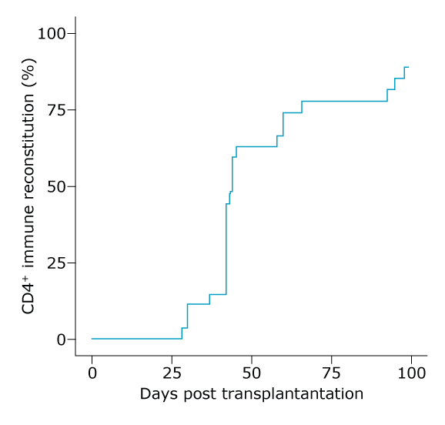
Body weight and ALC-based r-ATG Nomogram Dosing in Patients with Inborn Errors of Metabolism
CD4⁺ recovery at 100 days post aHSCT
Bodyweight and ALC-based dosing of
r-ATG in pediatric aHSCT patients with inborn errors of metabolism proved to be successful.
Nomogram-based study; n=27; median age: 1.45 years
Outcome:
Robust and early CD4⁺ immune reconstitution
Low therapy-related mortality
Low GVHD incidence
T-cell reconstitution at 100 days=85%
Drozdov D, et al., Blood. 2022;140(1):4797–4798.
aHSCT: Allogenic hematopoietic stem cell transplantation; ALC: Absolute lymphocyte count; CD4⁺: Cluster of differentiation 4⁺; r-ATG: Rabbit anti-thymocyte globulin.
Notes:
Several studies were conducted to understand the impact of individualizing the rabbit anti-thymocyte globulin (r-ATG) dosing, and one of them was a study to understand the effect of individualizing r-ATG dosing in pediatric patients with inborn errors of metabolism.
The principle adopted for the intervention was based on the absolute lymphocyte count and body weight-based r-ATG nomogram dosing. About 27 patients were enrolled in the study, and the mean age of the patients was 1.45 years. Ten of the 27 patients were female.
The results of the study were as follows:
Twenty-two of the 27 patients reached cluster of differentiation 4⁺ (CD4⁺) recovery at 100 days (85%) and the median time for neutrophil engraftment was 14 days and no graft failure was observed, thus, leading to the conclusion that:
The individualized dosing regimen in pediatric patients with inborn errors of metabolism can produce:
Robust and early CD4⁺ immune reconstitution
There is very low therapy-related mortality, and
Low graft vs. host disease incidence
Reference
Drozdov D, Long SL, Gupta AO, et al. Bodyweight and absolute lymphocyte count based dosing of rabbit anti-thymocyte globulin results in early CD4+ immune reconstitution in patients with inborn errors of metabolism undergoing umbilical cord blood transplantation. Blood. 2022;140(1):4797–4798.

Slide 16
Optimal Active r-ATG Exposure Associated with Minimum Risk of Virus Reactivation
Study Design
Objective
Outcome
Conclusion
Total AUC of active r-ATG is the best predictor for virus reactivation and aGVHD.
Higher total AUC is associated with higher risk of virus reactivation and lower risk of aGVHD
Optimal r-ATG (total AUC of active
r-ATG)=100 to 148.5 UE/mL/day
Results indicate:
Individualized dosing of r-ATG in aHSCT might reduce the risk of virus reactivation and effectively prevent aGVHD simultaneously.
Single center prospective study on adult haplo-PBSCT patients with hematological malignancies;
n=106
Duration:
1st September 2018 to 1st June 2020
To identify optimal r-ATG exposure that ensures:
Engraftment
Effective prevention of aGvHD
Reduced risk of viral reactivation
aGvHD: Acute graft versus host disease; aHSCT: Allogenic hematopoietic stem cell transplantation; ALC: Absolute lymphocyte count; ; AUC: Area under the curve; CD4⁺: Cluster of differentiation 4⁺; PBSCT: Peripheral blood stem cell transplantation; r-ATG: Rabbit anti-thymocyte globulin; UE: Equivalent units.
Wang H, et al., Transplant Cell Ther. 2022;28(6):332.e1–332.e10.
Notes:
Finally, in today’s session, we have another analysis that studied an optimal active rabbit anti-thymocyte globulin (r-ATG) exposure associated with minimum risk of virus reactivation. This was a single-center study on adult patients undergoing haploidentical peripheral blood stem cell transplantation with hematological malignancies. One hundred and six patients were enrolled between 1 September 2018 and 1 June 2020.
The aim of the study was to analyze the effect of optimal r-ATG exposure on engraftment, effective prevention of aGvHD, and risk of viral reactivation.
The outcome of the study was as follows:
It was found that the total area under the curve (AUC) of active r-ATG is the best predictor for viral reactivation and acute graft vs. host disease (aGvHD).
While there is an increased risk of viral reactivation with an increase in total AUC of active r-ATG, the risk of aGvHD decreases.
Optimal total AUC of active r-ATG was found to be 100–148.5 equivalent units per milliliter per day.
Thus, it was concluded that individualizing the dose of r-ATG in allogeneic hematopoietic stem cell transplantation might reduce the risk of virus reactivation and simultaneously prevent aGVHD.
Reference
Wang H, Zhao Y, Fang S, et al. Optimal active anti-thymocyte globulin exposure associated with minimum risk of virus reactivation and comparable acute graft-versus-host disease under adult myeloablative haploidentical peripheral blood stem cell transplantation. Transplant Cell Ther. 2022;28(6):332.e1–332.e10.

Slide 17

Individualization of r-ATG Dosing and the Way Forward
Emerging clinical evidences from attempts at individualizing r-ATG dose based on ALC +/- weight guided r-ATG exposure are quite encouraging and lend credence to further evaluation attempts in the form of large scale random clinical trails!
ALC: Absolute lymphocyte count; ; r-ATG: Rabbit anti-thymocyte globulin.
Notes:
To summarize, dose individualization did not result in a rise in graft vs. host disease or graft failure. With an increasing body of data supporting individualized rabbit anti-thymocyte globulin (r-ATG) dosing based on absolute lymphocyte count with or without weight-based r-ATG exposure is quite encouraging. This emerging clinical evidence also supports the need for a randomized phase 3 trial with the endpoint of overall survival, which would provide a more definitive judgement on the added value of individualized r-ATG dosing.

Slide 18
Thank you
Notes:
Thank you everyone.

Slide 19

For the use of a registered medical practitioner only.
For further information/access to full text articles, please reach out to us at : Dipanjan.Bhattacharjee@sanofi.com
The above information is based on recent scientific updates.
For product-related information, please refer to their respective prescribing information.
For information on Sanofi products, please click on the link below:
https://www.sanofi.in/en/science-and-innovation/for-healthcare-professionals/product-information
For further details, please contact the undersigned:
Sanofi Healthcare India Private Limited, Sanofi House, CTS No. 117-B, L&T Business Park, Saki Vihar Road, Powai 400072, India.

